Slide 1
Snapshot of America’s Children 2022
AAPD Pediatric Oral Health Research and Policy Center

Slide 2
Topics
Child Demographics
Family and Community
Economic Standing
Education
Health Habits
Oral Health
Dental Visits
Parent Perspectives
Notes:
Topics – but before we look at child demographics, let’s take a look at your share of this market.

Slide 3
Market Share
Age Group | Pediatric Dentist Share
Under 2 | 43%
2 to 4 | 40%
5 to 17 | 23%
Under 17 | 26%

Slide 4
Child Demographics

Slide 5
Quiz Question 1
Is the U.S. population expected to become older or younger by 2050?
Neither. It will stay about the same.
Younger. The average age of Americans will go down.
Older. The average age will go up.
By 2050, everyone will look young to me!
Notes:
Answer: C
2020: 2050:
0-17: 22.1% of the population 20.1%
18-64: 61.0% 57.9%
65+ 16.9% 22.0%
https://www.childstats.gov/americaschildren/tables/pop2.asp

Slide 6
Child Population
Number of children in the U.S. in 2020: 72.8 million
This represents 22% of the total population
Number of children in the U.S. projected for 2050: 78.2 million
This represents 20% of the total population
Notes:
Previous predictions of a large increase in the child population have changed…in fact, the nation is getting older.
https://www.childstats.gov/americaschildren/tables/pop1.asp accessed February 1, 2022

Slide 7
U.S. Demographics
Race and Ethnicity Percentages | 2022 | 2050
Hispanic | 25.8 | 30.8
Non-Hispanic
White | 49.2 | 39.4
Black | 13.9 | 13.9
American Indian/Alaska Native | 0.8 | 0.7
Asian | 5.4 | 7.2
Native Hawaiian/Pacific Islander | 0.2 | 0.2
Two or more races | 4.8 | 7.7
Notes:
POP3 RACE AND HISPANIC ORIGIN COMPOSITION: PERCENTAGE OF U.S. CHILDREN AGES 0–17 BY RACE AND HISPANIC ORIGIN, 1980–2020 AND PROJECTED 2021–2050
https://www.childstats.gov/americaschildren/tables/pop3.asp

Slide 8
Family and Community

Slide 9
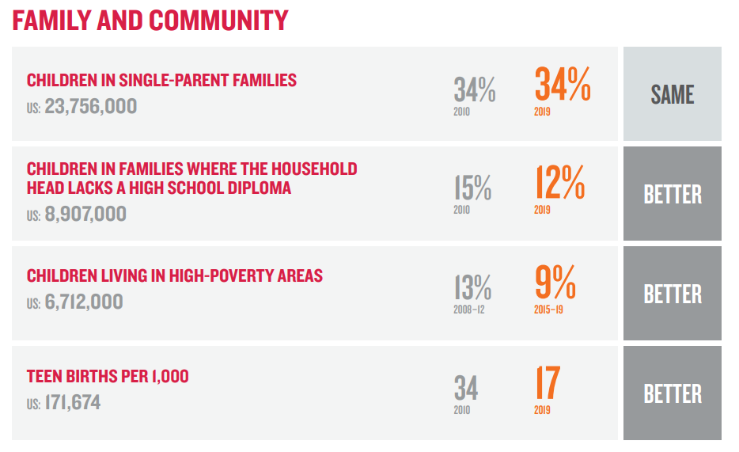

Slide 10
Quiz Question 2
During the last ten years, youth ages 12-17 involved in serious crimes either as a victim or an offender has:
Increased
Decreased
Stayed the same
Take my wallet and cellphone, just please don’t hurt me
Notes:
Answer: B

Slide 11
Family and Community
Serious violent crime victimization of youth ages 12 – 17 in 2020 6 per 1,000
Serious violent crime victimization of youth ages 12 – 17 in 2008 12 per 1,000
Youth offenders ages 12 – 17 involved in serious crimes in 2020 8 per 1,000
Youth offenders ages 12 – 17 involved in serious crimes in 2008 14 per 1,000
Notes:
Crime rates have dropped in general after a spike in the 90s-00s. (Cyclical) One proposed reason behind the falling juvenile crime rate is the increased attention being given to at-risk or troubled juveniles before they end up arrested for committing a crime.
https://www.childstats.gov/pdf/ac2021/ac_21.pdf pg viii accessed February 3, 2022

Slide 12
Economic Standing

Slide 13
Quiz Question 3
What percentage of U.S. children are classified as “food insecure”?
One in four.
One in six.
One in ten.
None. Pass the donuts.
Notes:
Answer: B
The percentage has dropped from a previous 1 in 5 children were food insecure, and in 2021, only 1 in 6. This is likely due greater federal support between 2020 and 2021.
https://www.feedingamerica.org/sites/default/files/2021-03/National%20Projections%20Brief_3.9.2021_0.pdf Accessed February 3, 2022

Slide 14
Food Insecurity
Low food security: reports of reduced quality, variety, or desirability of diet. Little or no indication of reduced food intake.
Very low food security: Reports of multiple indications of disrupted eating patterns and reduced food intake.
Food desert: parts of the country devoid of fresh fruit, vegetables, and other healthy foods, typically in impoverished areas.
Food swamp: neighborhoods saturated with fast food chains, corner stores, and other unhealthy food providers.
Notes:
Food desert: USDA definition http://americannutritionassociation.org/newsletter/usda-defines-food-deserts
Food swamp: https://emoryhumanhealth.org/2018/11/20/the-difference-between-a-food-desert-and-a-food-swamp/

Slide 15
Economic Standing
Children living in poverty in 2020: 16%
Households with children reporting shelter cost burden, crowding, and/or physically inadequate housing in 2019: 38%
Notes:
Source: https://publications.aap.org/aapnews/news/15633 Accessed February 3, 2022
16.1% living in poverty represents a 1.7% increase from 2019, or 1.1 million more children
Source: https://www.feedingamerica.org/sites/default/files/2021-03/National%20Projections%20Brief_3.9.2021_0.pdf Accessed February 3, 2022
Source: https://www.childstats.gov/americaschildren/phys5.asp
Data from 2020 unavailable, but an educated guess that this percentage has increased.

Slide 16
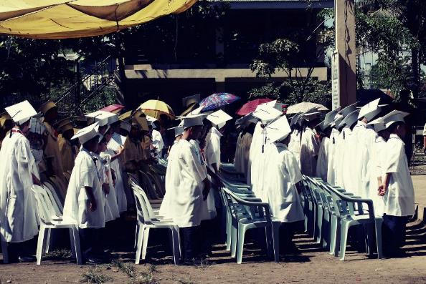
Education

Slide 17
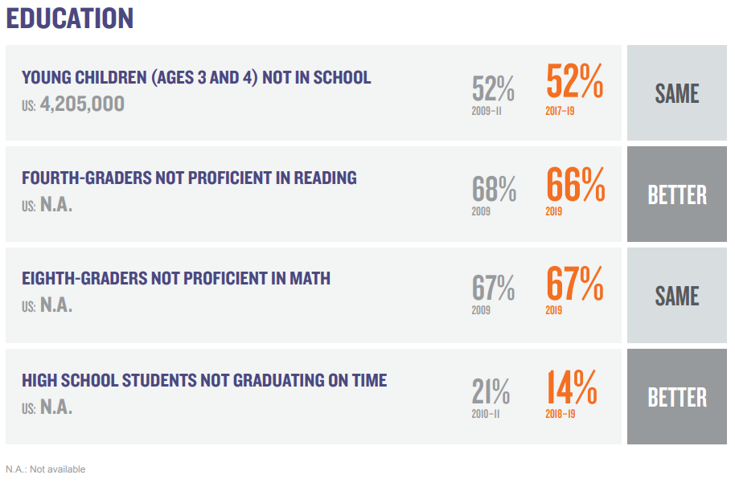
Notes:
Education was improving – note 2009 to 2019! Pre-pandemic numbers

Slide 18
Education
Children who speak a language other than English at home: 23%
Children who speak a language other than English at home and who have difficulty speaking English: 4%
Children ages 3-5 who were read to 3 or more times in the last week: 85%
Notes:
Most recent data is from 2019
The percentage of school-age children who spoke a language other than English at home increased by 1 percentage point from 2010 to 2019, from about 22% to about 23%.
At the same time, the number of school-age children who spoke a language other than English at home and had difficulty speaking English decreased from about 5% in 2010 to about 4% in 2019.
https://www.childstats.gov/americaschildren/family5.asp
In 2019, approximately 85% of children ages 3–5 who were not yet in kindergarten were read to three or more times per week by a family member. This percentage was higher than the percentage in 1993 (78%), although it fluctuated in the intervening years.
https://www.childstats.gov/americaschildren/edu1.asp

Slide 19
Health Habits

Slide 20
Weight and Weight Perceptions
Obese: 15%
Overweight: 16%
Perceives Overweight: 32%
Trying to Lose Weight: 47%
Notes:
About 31% of students would be considered a non-healthy weight, yet 47% (at least 16% of whom are at a healthy weight) are actively trying to lose weight during the years that their body is still developing
Obese = ≥95th percentile 2000 CDC growth charts.
Overweight = ≥85th percentile but <95th percentile
Source: Kann L, McManus T, Harris WA, et al. Youth Risk Behavior Surveillance — United States, 2017.

Slide 21
Quiz Question 4
What is the average amount of screen time per day that children have?
Less than an hour
Between 3 and 4 hours
Between 6 and 7 hours
24 hours. They’re always on their iPads!

Slide 22
Screen Time
Age | Average Number of Hours per Age Group
0-2 | 0:42
2-4 | 2:40
5-8 | 3:00
9-12 | 4:44
13-18 | 7:22
Notes:
These stats are from the Common Sense Media Report. Ages 0-8 are from 2017. Ages 8-18 are from 2019. (commonsensemedia.org)

Slide 23
Quiz Question 5
How have the health habits of U.S. teens changed between 2009 and 2019?
Smoking, alcohol and drug use have all increased.
Smoking has decreased; use of alcohol and drugs has increased.
Smoking and alcohol have decreased; drug use has increased.
Smoking, alcohol and drug use have all decreased.
Notes:
Answer: C

Slide 24
Use of Alcohol
Students who reported having 5 or more alcoholic beverages in a row in the past 2 weeks | 2005 | 2019
8th grade | 11% | 4%
12th grade | 29% | 14%
Notes:
In 2019, the percentage of 12th grade students who reported binge drinking were the lowest since the survey began in 1980 - when it was 41%.
Source: America’s Children: Key National Indicators of Well-Being, 2019, www.childstats.gov

Slide 25
Use of Alcohol 2021
Notes:
Alcohol: The percentage of students who reported using alcohol within the past year decreased significantly
the Monitoring the Future survey https://www.drugabuse.gov/drug-topics/trends-statistics/monitoring-future

Slide 26
Smoking
Students who reported smoking cigarettes daily in the past 30 days | 2005 | 2019
8th grade | 4% | 2%
12th grade | 16% | 2%
Notes:
In 2019, the percentage of 8th-, and 12th-grade students who reported smoking cigarettes daily in the past 30 days has continued to be the lowest since data collection began in 1980.
Source: America’s Children: Key National Indicators of Well-Being, 2019, www.childstats.gov

Slide 27
Vaping Nicotine 2021
Notes:
-Eighth graders: 12.1% reported vaping nicotine in the past year in 2021, compared to 16.6% in 2020 -10th graders: 19.5% reported vaping nicotine in the past year in 2021, compared to 30.7% in 2020 -12th graders: 26.6% reported vaping nicotine in the past year in 2021, compared to 34.5% in 2020 --Any illicit drug, other than marijuana: The percentage of students who reported using any illicit drug (other than marijuana) within the past year decreased significantly for eighth, 10th, and 12th grade students.
https://www.drugabuse.gov/drug-topics/trends-statistics/monitoring-future

Slide 28
Quiz Question 7
How many high school seniors reported having used prescription opioids non-medically?
1 in 100
1 in 25
1 in 8
All of them. Except my kids.
Notes:
One in 8 high school seniors (about 13%) report having used prescription opioids in a non-medical way – and of those students – more than half report using the prescription drugs in combination with at least one other substance in the past year. Marijuana and alcohol were the most common.
https://www.drugabuse.gov/related-topics/trends-statistics/infographics/teens-mix-prescription-opioids-other-substances

Slide 29
Use of Drugs
Students who reported using illicit drugs in the past 30 days | 2005 | 2019
8th grade | 8% | 9%
12th grade | 23% | 25%
Notes:
The percentage of students who reported using illicit drugs in the past 30 days has increased during this time period. However, within the past year it has decreased
Source: America’s Children: Key National Indicators of Well-Being, 2019, www.childstats.gov

Slide 30
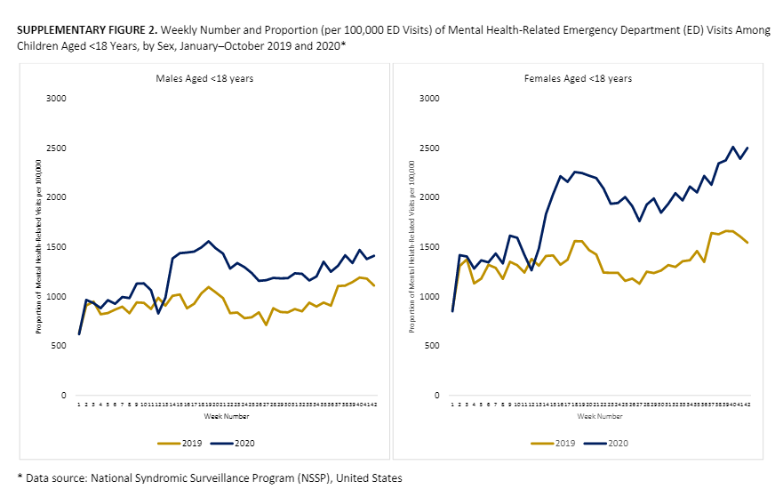
Mental Health Impact
Notes:
Increases in ED visits in 2020 starting in March/April compared to 2019
https://stacks.cdc.gov/view/cdc/96610

Slide 31
General Health and Oral Health
Tooth decay is associated with:
Life-threatening infection
Significant pain
Chewing difficulty
Malnutrition
Delayed or insufficient growth
Poor speech articulation
Poor sleep habits
Low self-esteem
Social ostracism
Poor school performance
Diminished quality of life

Slide 32
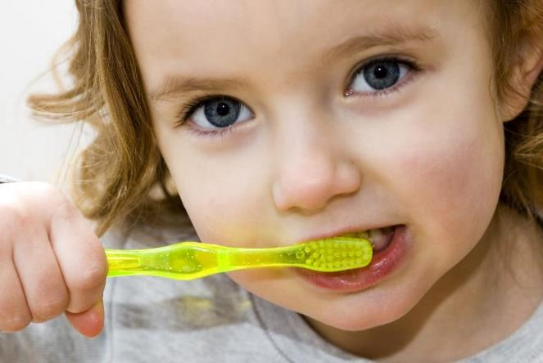
Oral Health

Slide 33
Caries Prevalence by Age
Age of Child | Total Caries | Untreated Caries
2 – 5 | 18% | 5%
6 – 11 | 45% | 15%
12 – 19 | 54% | 13%
2 – 19 | 43% | 13%
Notes:
From one set of data: Among youth aged 2–19 years, the prevalence of total dental caries was highest for Hispanic youth (52%) compared with black (44.3%), Asian (42.6%), and white youth (39.0%). The prevalence of untreated dental caries was highest among black children (17%) compared with Hispanic (13.5%), white (11.7%), and Asian children (10.5%).
From NIDCR: “American Indian and Alaska Native (AI/AN) children aged 6 to 8 years are twice as likely to have untreated dental caries in their primary teeth, and five times more likely to have untreated caries in their permanent teeth than U.S. children overall. Mexican American and non-Hispanic Black children are more than twice as likely to have untreated dental caries than non-Hispanic White children

Slide 34
Quiz Question 8
Which race or ethnicity had the highest prevalence of total dental caries in 2021?
White
Black
Hispanic
Asian
American Indian/Alaska Native
Notes:
“American Indian and Alaska Native (AI/AN) children aged 6 to 8 years are twice as likely to have untreated dental caries in their primary teeth, and five times more likely to have untreated caries in their permanent teeth than U.S. children overall. Mexican American and non-Hispanic Black children are more than twice as likely to have untreated dental caries than non-Hispanic White children

Slide 35
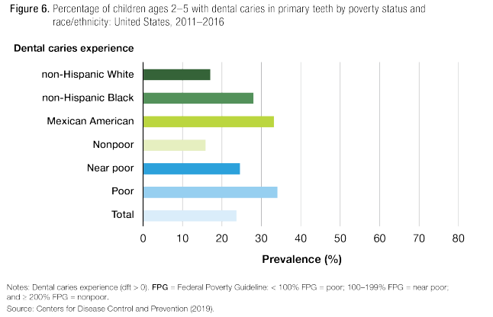
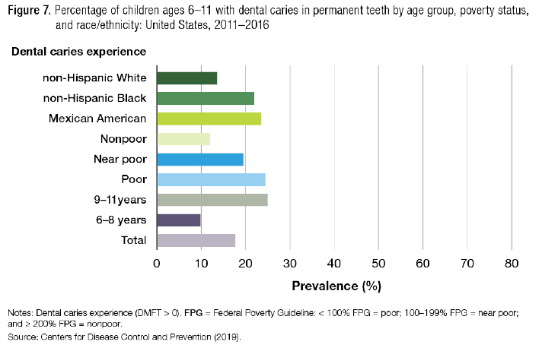
Caries Prevalence by Age, Race and Ethnicity, and Poverty Status
Source: America’s Children: Key National Indicators of Well-Being, 2020, www.childstats.gov
Notes:
From these charts we can see that both household income AND race/ethnicity impact caries prevalence

Slide 36
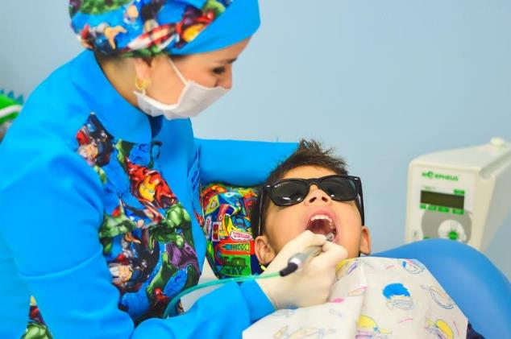
Dental Visits

Slide 37
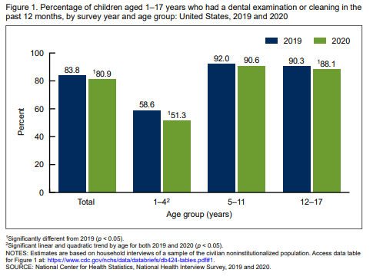
Dental Visits by Age
Notes:
Significantly different decrease between 2019 and 2020
Between 2019 and 2020, the percentage of children aged 1–17 years who had a dental examination or cleaning in the past 12 months decreased by nearly 3 percentage points, from 83.8% to 80.9%.
This pattern was especially apparent among children aged 1–4 years, who had a 7.3 percentage point decrease during this period and were already less likely than older children to have had a dental visit.

Slide 38
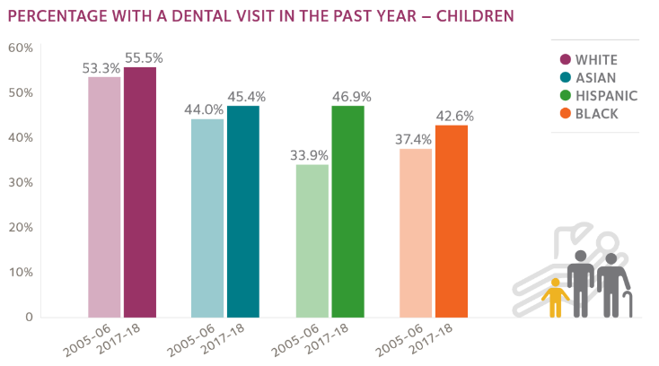
Dental Visits by Race/Ethnicity
Notes:
This is data from 2018

Slide 39
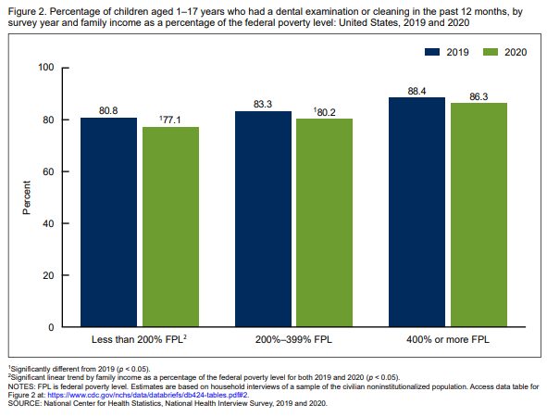
Dental Visits by Poverty Status
Notes:
Children aged 1–17 years living in families with lower incomes (below 400% of the federal poverty level) were less likely to have had an annual dental examination or cleaning in 2020 than in 2019. Visits continue to be influenced by household income.
Adjaye-Gbewonyo D, Black LI. Dental Care Utilization Among Children Aged 1–17 Years: United States, 2019 and 2020. NCHS data brief. 2021 Dec(424):1-8.

Slide 40
Dental Visits by Insurance Type
Notes:
Dental care utilization among children covered by public insurance increased from 35 percent in 2005 to 50 percent in 2016, thus narrowing the gap in dental care utilization between Medicaid-enrolled and privately insured children. In 46 states and DC, dental care utilization among children with private dental benefits was higher than among Medicaid-enrolled children. However, Texas and Hawaii had a “reverse” gap, utilization among Medicaid-enrolled children was higher..
Vujicic M, Nasseh, K. Gap in dental care utilization between Medicaid and privately insured children narrows, remains large for adults. Health Policy Institute Research Brief. American Dental Association. December 2015
(Revised). Available from: http://www.ada.org/~/media/ADA/Science%20and%20Research/HPI/Files/HPIBrief_0915_1.ashx.

Slide 41
Parent Perspectives

Slide 42
Parent Referrals
Children Offered Advice from Their Healthcare Provider about Need for a Dental Visit
Children ages 2 – 5 57%
Children ages 6 – 12 54%
Children ages 13 – 17 46%
Children ages 2 – 17 52%
Notes:
In 2011, a little more than half (52%) of children between the ages of 2 and 17 were offered advice from a health care provider about the need for timely routine dental checkups. Up from 2008, less than half (48 percent).

Slide 43
Quiz Question 10
If children have their first dental visit at four years or younger, rather than four years or older, their parents benefit from an average cost savings of:
$360
$695
No savings, due to the cost of more visits
Priceless!
Notes:
Answer: A
Children whose first dental visit was four years or younger had a total dental cost over eight years of $360 less than children whose first dental visit was older than four years
Nowak, A. J., P. S. Casamassimo, J. Scott, and R. Moulton. 2016. “Do Early Dental Visits Reduce Treatment and Treatment Costs for Children?” The Journal of the Michigan Dental Association 98 (1): 36–42.

Slide 44
Snapshot of America’s Children 2022
AAPD Pediatric Oral Health Research and Policy Center
Robin Wright, PhD: rwright@aapd.org

