Slide 1
Effective Collaboration: Chapter Development of Key Policy Statement
Jonathon Everett Lee, DDS, FAPD, FACD
President
Natalie Mansour DMD
Interim Public Policy Advocate , Chair of Patient Services Committee and Board Director
California Society of Pediatric Dentistry

Slide 2
Background
The Story of Caleb Sears

Slide 3
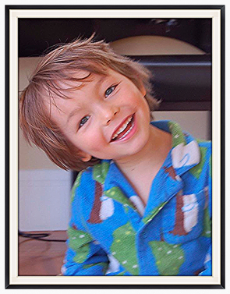
Who Is Caleb Sears?

Slide 4
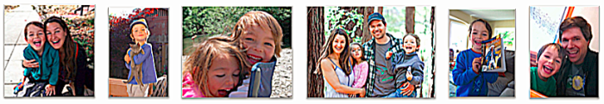
Caleb Sears
Caleb Sears was a healthy six-year-old living in the Bay Area. He was in his first year of elementary school and just starting to read and write. He loved playing with his little sister, climbing trees, singing Les Miserables, and making up funny stories about llamas and time machines.
In March 2015, Caleb went with his parents to a reputable oral surgeon’s office to have a mesiodens extraction, a necessary but elective dental procedure. Caleb stopped breathing after general anesthesia, (including the drugs Propofol, Fentanyl, Ketamine, and Versed,) was administered.
The oral surgeon was performing the procedure alone in his office with his dental assistant and a sedation assistant. Moments passed before anyone noticed that Caleb had stopped breathing. He suffered irreversible massive injuries and died.

Slide 5
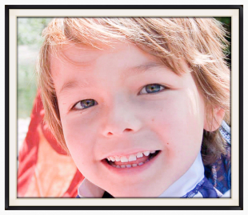
California Assembly Bill No. 2235 “Caleb’s Law”
Caleb's Law was signed into law in California by Governor Brown on September 23, 2016 and it went into effect on January 1, 2017.*
It requires that the Dental Board of California establish a committee to study the safety of pediatric anesthesia in dental offices and whether additional safety measures would reduce the potential for injury or death in minors. These findings will be reported to the Board and be made publicly available.
It requires that people licensed by the Dental Board to administer general anesthesia inform a child’s parent or guardian of the differing practice models and safety precautions currently in place.
It facilitates the epidemiological study of pediatric anesthesia and sedation by requiring the Dental Board to collect more information regarding adverse events.

Slide 6
*AB224 Dentistry: anesthesia and sedation assembly Bill
*A follow up bill to change the way anesthesia is administered in dental offices and make it safer for children undergoing sedation and anesthesia .
Proposed the requirement of having a separate dentist operator and separate anesthesia provider model of care for children aged 6 and under during general anesthesia.
Sponsored By The American Academy of Pediatrics
Authored by Assemblyman Tony Thurmond
CSPD Position was “Watch”
As recommended by the CSPD PPA and Approved by the CSPD Board

Slide 7
Complex Landscape Two Sedation Bills
The Introduction of SB501

Slide 8
SB501 Dentistry: anesthesia and sedation Senate Bill
This bill proposes to change the practice of sedation for levels of minimal to moderate.
As presented to CSPD, it was silent on General Anesthesia.
Sponsor : The California Association of Oral and Maxillofacial Surgeons (CALAOMS)
Author: Senator Steve Glazer
CSPD Initial Position: Support if Amended
Amended to AAPD Guidelines
As recommended by the CSPD PPA and Approved by the CSPD Board

Slide 9
Our Members, Partners and Stakeholders
Started Asking Questions

Slide 10
Members, Partners & Stakeholders
"The operator-anesthesia model, where the operating dentist or oral surgeon is simultaneously directing the deep sedation or general anesthesia care AND involved in the conduct of the surgery, is inadequate and outdated, according to medical standards, and below the expectations for safety that the public deserves." ~Dr. Stephen Wilson MA, DMD, PhD, co-author of the nationally agreed upon Guidelines for the Monitoring and Management of Pediatric Patients Before, During, and After Sedation for Diagnostic and Therapeutic Procedures: Update 2016.
"A second qualified, CMS-recognized*, anesthesia provider must be present whenever children need moderate sedation, deep sedation, or general anesthesia for major dental procedures." ~Letter from the California Society of Anesthesiologists 2017 (*CMS: Centers for Medicare and Medicaid Services)
"Only qualified anesthesia professionals should administer deep sedation or general anesthesia to children while a separate dentist or oral surgeon performs the procedure." ~Charles J. Cote, MD, Professor Emeritus, Harvard Medical School and co-author of the nationally agreed upon Guidelines for the Monitoring and Management of Pediatric Patients Before, During, and After Sedation for Diagnostic and Therapeutic Procedures: Update 2016.

Slide 11
Then Why?
When considering a dental procedures involving general anesthesia or deep sedation in children, pediatric dentists have a separate person, an anesthesiologist in the room to administer the anesthesia and monitor and provide airway and rescue support as needed until recovery.
Why is CSPD watching AB 224 and not supporting it?
Why is CSPD supporting SB501 when it does not follow the AAPD Best Practices?

Slide 12
Resolution
Look to our Vision and Mission Statement and Governance for the Answers
Follow our Parent Organization AAPD
Do What is in Our Guidelines and What Is Best Practices

Slide 13
CSPD Vision and Mission Statements
The Vision of the California Society of Pediatric Dentistry is exemplary oral health for all infants, children and adolescents.
The Mission of the California Society of Pediatric Dentistry (CSPD) is to serve its membership and the public by advocating optimal oral health of infants, children and adolescents in the state of California.

Slide 14
CSPD Governance
The CSPD Public Policy Advocate (PPA)
The CSPD Patient Services Committee
The Patient Services Committee is a standing committee of CSPD.
The duty of this committee to promote and make recommendations to improve patient safety in the dental office and to advise recognized professional, lay and governmental organizations of the Clinical Guidelines and Oral Health Policies of this organization and the American Academy of Pediatric Dentistry (AAPD) as they relate to all phases of dentistry for Infants, children, and adolescents including those with special health care needs.
Two very important and knowledgeable governance assets that for some reason never had the opportunity to work together.

Slide 15
CSPD PPA-PSC Collaboration
As President, I requested that the PPA began to work and collaborate with the Patient Services Chair on Legislative Issues.
This would allow for leadership development
More discourse and dialogue on issues
Lessen committee work discussions at the Board Table.
I also tasked The Patient Services Committee through its Chair, Dr Natalie Mansour, to develop a Policy Statement on Sedation.

Slide 16
Our Parent Organization
AAPD Strategic Plan and Reference Manual

Slide 17
The AAPD Strategic Plan and Its Culture Statement
Our members put children first in everything they do, and at the highest standards of ethics and patient safety. As such, the American Academy of Pediatric Dentistry is THE leading national advocate dedicated exclusively to children’s oral health. We are the embodiment of our members’ expertise as the big authorities on little teeth.
The Derivative for CSPD
Our members put children first in everything they do, and at the highest standards of ethics and patient safety. As such, CSPD is THE leading advocate in the State of California dedicated exclusively to children’s oral health. CSPD is the embodiment of our members’ expertise as the authorities and experts on pediatric oral health.

Slide 18
AAPD Reference Manual
Policy on Patient Safety
Monitoring and Management of Pediatric Dental Patients, Before, During and After Sedation for Diagnostic and Therapeutic Procedures: Update 2016. 278-307.
Use of Anesthesia Providers in the Administration of Office-based Deep Sedation/General Anesthesia to the Pediatric Dental Patient.

Slide 19
THE CALIFORNIA SOCIETY OF PEDIATRIC DENTISTRY POSITION STATEMENT and LEGISLATIVE POLICY REGARDING MINIMAL, MODERATE AND DEEP SEDATION/GENERAL ANESTHESIA USED DURING DENTAL TREATMENT OF CHILDREN
ADOPTED BY THE CALIFORNIA SOCIETY OF PEDIATRIC DENTISTRY
BOARD OF DIRECTORS: JULY 19, 2018

Slide 20
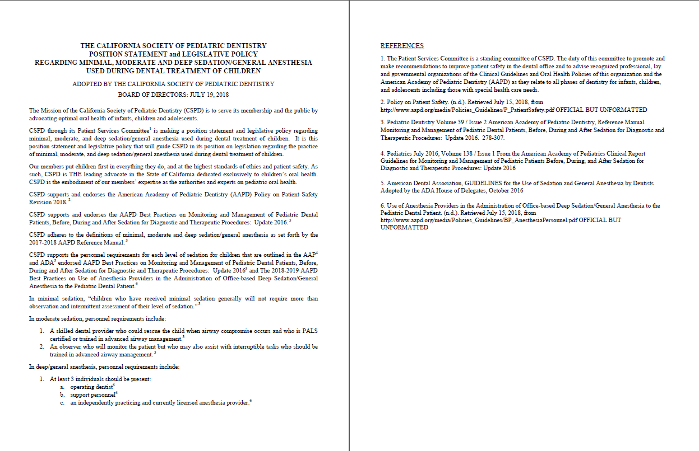

Slide 21
CSPD Position and Policy Statement:
The Mission of the California Society of Pediatric Dentistry (CSPD) is to serve its membership and the public by advocating optimal oral health of infants, children and adolescents.
CSPD through its Patient Services Committee¹ is making a position statement and legislative policy regarding minimal, moderate, and deep sedation/general anesthesia used during dental treatment of children. It is this position statement and legislative policy that will guide CSPD in its position on legislation regarding the practice of minimal, moderate, and deep sedation/general anesthesia used during dental treatment of children.

Slide 22
CSPD Position and Policy Statement:
Our members put children first in everything they do, and at the highest standards of ethics and patient safety. As such, CSPD is THE leading advocate in the State of California dedicated exclusively to children’s oral health. CSPD is the embodiment of our members’ expertise as the authorities and experts on pediatric oral health.

Slide 23
CSPD Position and Policy Statement:
CSPD supports and endorses the American Academy of Pediatric Dentistry (AAPD) Policy on Patient Safety Revision 2018. ²
CSPD supports and endorses the AAPD Best Practices on Monitoring and Management of Pediatric Dental Patients, Before, During and After Sedation for Diagnostic and Therapeutic Procedures: Update 2016. ³
CSPD adheres to the definitions of minimal, moderate and deep sedation/general anesthesia as set forth by the 2017-2018 AAPD Reference Manual. ³

Slide 24
CSPD Position and Policy Statement:
CSPD supports the personnel requirements for each level of sedation for children that are outlined in the AAP4 and ADA5 endorsed AAPD Best Practices on Monitoring and Management of Pediatric Dental Patients, Before, During and After Sedation for Diagnostic and Therapeutic Procedures: Update 2016³ and The 2018-2019 AAPD Best Practices on Use of Anesthesia Providers in the Administration of Office-based Deep Sedation/General Anesthesia to the Pediatric Dental Patient.⁶

Slide 25
CSPD Position and Policy Statement:
In minimal sedation, “children who have received minimal sedation generally will not require more than observation and intermittent assessment of their level of sedation.” ³
In moderate sedation, personnel requirements include:
1. A skilled dental provider who could rescue the child when airway compromise occurs and who is PALS certified or trained in advanced airway management.³
2. An observer who will monitor the patient but who may also assist with interruptible tasks who should be trained in advanced airway management. ³

Slide 26
CSPD Position and Policy Statement:
In deep/general anesthesia, personnel requirements include:
1. At least 3 individuals should be present:
a. operating dentist⁶
b. support personnel⁶
c. an independently practicing and currently licensed anesthesia provider.⁶

Slide 27
CSPD Position and Policy Statement References:
1. The Patient Services Committee is a standing committee of CSPD. The duty of this committee to promote and make recommendations to improve patient safety in the dental office and to advise recognized professional, lay and governmental organizations of the Clinical Guidelines and Oral Health Policies of this organization and the American Academy of Pediatric Dentistry (AAPD) as they relate to all phases of dentistry for infants, children, and adolescents including those with special health care needs.
2. Policy on Patient Safety. (n.d.). Retrieved July 15, 2018, from http://www.aapd.org/media/Policies_Guidelines/P_PatientSafety.pdf OFFICIAL BUT UNFORMATTED
3. Pediatric Dentistry Volume 39 / Issue 2 American Academy of Pediatric Dentistry, Reference Manual. Monitoring and Management of Pediatric Dental Patients, Before, During and After Sedation for Diagnostic and Therapeutic Procedures: Update 2016. 278-307.

Slide 28
CSPD Position and Policy Statement References:
4. Pediatrics July 2016, Volume 138 / Issue 1 From the American Academy of Pediatrics Clinical Report Guidelines for Monitoring and Management of Pediatric Patients Before, During, and After Sedation for Diagnostic and Therapeutic Procedures: Update 2016
5. American Dental Association, GUIDELINES for the Use of Sedation and General Anesthesia by Dentists Adopted by the ADA House of Delegates, October 2016
6. Use of Anesthesia Providers in the Administration of Office-based Deep Sedation/General Anesthesia to the Pediatric Dental Patient. (n.d.). Retrieved July 15, 2018, from http://www.aapd.org/media/Policies_Guidelines/BP_AnesthesiaPersonnel.pdf OFFICIAL BUT UNFORMATTED

Slide 29
Epilogue
Do the Right Thing for the Children

Slide 30
The California Society of Pediatric Dentistry Position on SB501
August 28, 2018

Slide 31
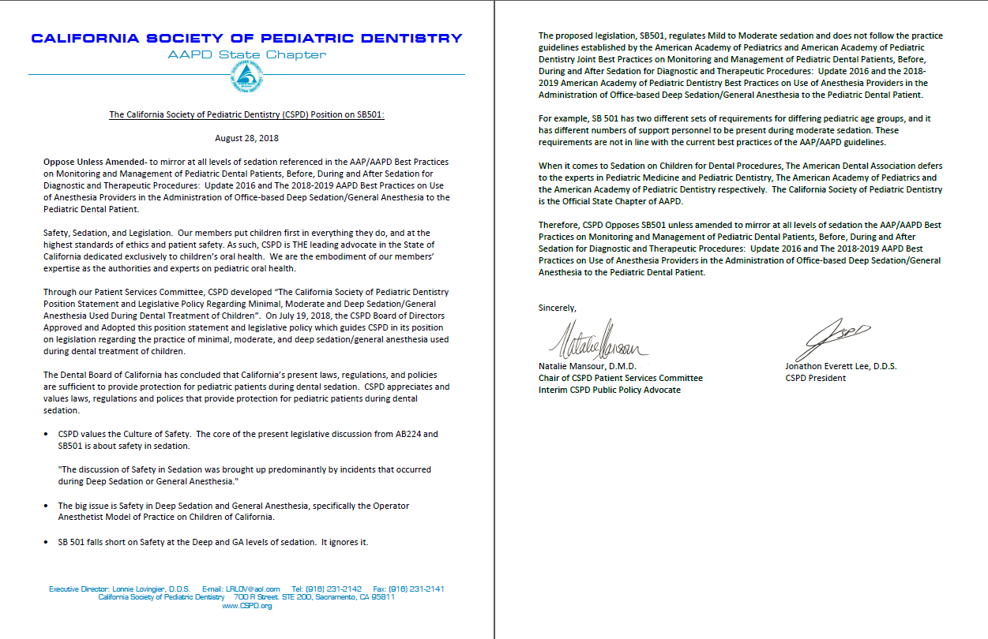

Slide 32
SB501 Position: Oppose Unless Amended-
To mirror at all levels of sedation referenced in the AAP/AAPD Best Practices on Monitoring and Management of Pediatric Dental Patients, Before, During and After Sedation for Diagnostic and Therapeutic Procedures: Update 2016 and The 2018-2019 AAPD Best Practices on Use of Anesthesia Providers in the Administration of Office-based Deep Sedation/General Anesthesia to the Pediatric Dental Patient.

Slide 33
SB501 Position: Oppose Unless Amended-
Safety, Sedation, and Legislation. Our members put children first in everything they do, and at the highest standards of ethics and patient safety. As such, CSPD is THE leading advocate in the State of California dedicated exclusively to children’s oral health. We are the embodiment of our members’ expertise as the authorities and experts on pediatric oral health.

Slide 34
SB501 Position: Oppose Unless Amended-
Through our Patient Services Committee, CSPD developed “The California Society of Pediatric Dentistry Position Statement and Legislative Policy Regarding Minimal, Moderate and Deep Sedation/General Anesthesia Used During Dental Treatment of Children”. On July 19, 2018, the CSPD Board of Directors Approved and Adopted this position statement and legislative policy which guides CSPD in its position on legislation regarding the practice of minimal, moderate, and deep sedation/general anesthesia used during dental treatment of children.

Slide 35
SB501 Position: Oppose Unless Amended-
The Dental Board of California has concluded that California’s present laws, regulations, and policies are sufficient to provide protection for pediatric patients during dental sedation. CSPD appreciates and values laws, regulations and polices that provide protection for pediatric patients during dental sedation.

Slide 36
SB501 Position: Oppose Unless Amended-
CSPD values the Culture of Safety. The core of the present legislative discussion from AB224 and SB501 is about safety in sedation.
"The discussion of Safety in Sedation was brought up predominantly by incidents that occurred during Deep Sedation or General Anesthesia."
The big issue is Safety in Deep Sedation and General Anesthesia, specifically the Operator Anesthetist Model of Practice on Children of California.
SB 501 falls short on Safety at the Deep and GA levels of sedation. It ignores it.

Slide 37
SB501 Position: Oppose Unless Amended-
The proposed legislation, SB501, regulates Mild to Moderate sedation and does not follow the practice guidelines established by the American Academy of Pediatrics and American Academy of Pediatric Dentistry Joint Best Practices on Monitoring and Management of Pediatric Dental Patients, Before, During and After Sedation for Diagnostic and Therapeutic Procedures: Update 2016 and the 2018-2019 American Academy of Pediatric Dentistry Best Practices on Use of Anesthesia Providers in the Administration of Office-based Deep Sedation/General Anesthesia to the Pediatric Dental Patient.
For example, SB 501 has two different sets of requirements for differing pediatric age groups, and it has different numbers of support personnel to be present during moderate sedation. These requirements are not in line with the current best practices of the AAP/AAPD guidelines.
When it comes to Sedation on Children for Dental Procedures, The American Dental Association defers to the experts in Pediatric Medicine and Pediatric Dentistry, The American Academy of Pediatrics and the American Academy of Pediatric Dentistry respectively. The California Society of Pediatric Dentistry is the Official State Chapter of AAPD.

Slide 38
SB501 Position: Oppose Unless Amended-
Therefore, CSPD Opposes SB501 unless amended to mirror at all levels of sedation the AAP/AAPD Best Practices on Monitoring and Management of Pediatric Dental Patients, Before, During and After Sedation for Diagnostic and Therapeutic Procedures: Update 2016 and The 2018-2019 AAPD Best Practices on Use of Anesthesia Providers in the Administration of Office-based Deep Sedation/General Anesthesia to the Pediatric Dental Patient.

Slide 39
AB224
What Happened To It?

Slide 40
AB224 Completely Rewritten
AB 224, as amended, Thurmond. Dentistry: anesthesia and sedation. California Housing Finance Agency: financing agreements: affordable rental housing for school employees.
Existing law establishes the California Housing Finance Agency, within the Department of Housing and Community Development, with the primary purpose of meeting the housing needs of persons and families of low or moderate income. Existing law authorizes the agency to make, or undertake commitments to make, loans to housing sponsors to finance certain types of housing developments and residential structures, as provided, and requires the agency to enter into regulatory contracts and other agreements with housing sponsors receiving these loans. Existing law, the Teacher Housing Act of 2016, authorizes school districts to establish and implement programs that address the housing needs of teachers and school district employees who face challenges in securing affordable housing.
This bill would specifically authorize the agency to enter into financing agreements with school districts, and developers that have partnered with school districts, for the creation of affordable rental housing, as defined, for school district employees, including teachers. The bill would require that payment on a loan provided pursuant to these provisions be deferred until the affordable rental housing financed by that loan is put into service and the school district begins collecting rent from the occupants of that affordable rental housing.
Existing law establishes the California Housing Finance Fund and continuously appropriates all money in the fund to the agency for purposes of financing the various programs that it administers. Existing law requires that all moneys accruing to the agency pursuant to specified provisions, including proceeds from revenue bonds and taxable securities issued by the agency, be deposited in the fund.
This bill, notwithstanding these provisions, would make funds available for its purposes only upon appropriation by the Legislature.
Assemblyman Tony Thurmond is running for State School Superintendent.

Slide 41
Thank You
Jonathon.Everett.Lee@gmail.com

Slide 42
Questions
Jonathon.Everett.Lee@gmail.com

