Slide 1
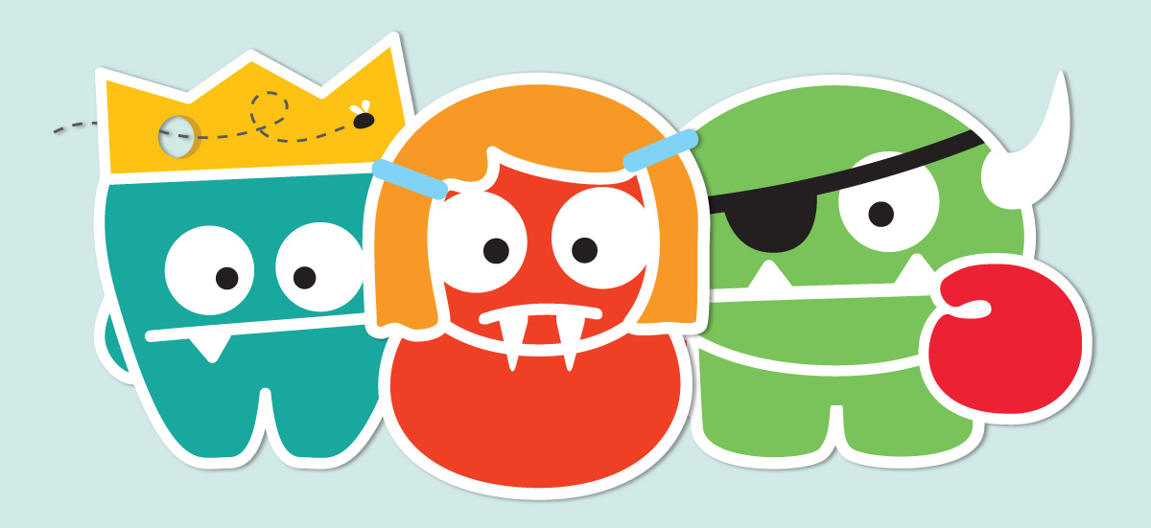
The Word of Mouth News for Little Teeth
NOVEMBER 2014
Has your family joined the Monster-Free Mouths Movement Yet?
Did you know tooth decay is the number one chronic infectious disease affecting children in the U.S.? The good news is it’s largely preventable. You have already taken the most important first step by establishing a Dental Home with a pediatric dentist – and we are so happy you selected us! Our goal is to make healthy oral habit fun and enjoyable. That is why we are joining with the American Academy of Pediatric Dentistry (AAPD) to ask parents and caregivers to banish the Mouth Monsters (aka tooth decay) by joining the Monster-Free Mouths Movement. It’s easy – just go to www.mychildrensteeth.org for tips and tools to help teach your kids about the importance of healthy oral habits. And don’t forget to schedule your child’s next six-month check-up today!
[INSERT DENTAL OFFICE]’s Monster-Free Mouth of the Month!
Name (first only): Age: Favorite toothpaste flavor:

Slide 2
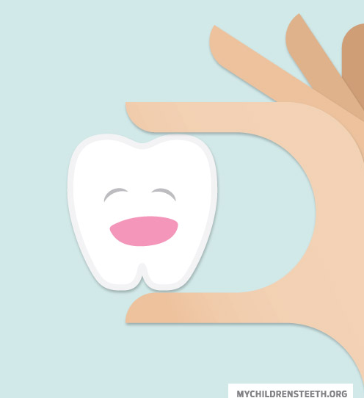
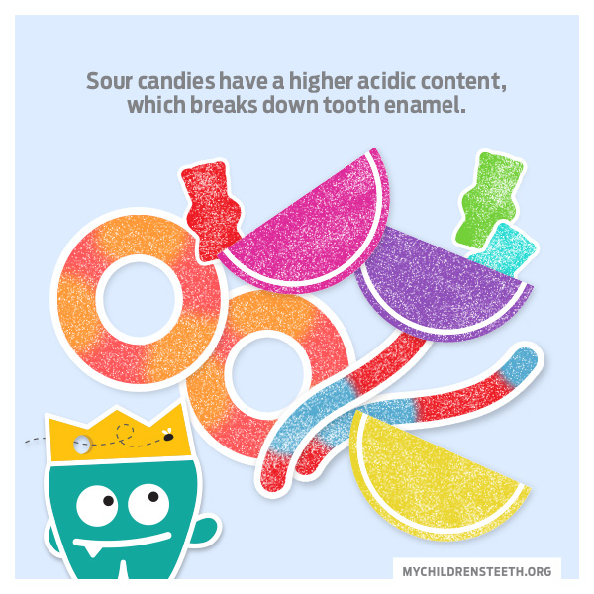
The Word of Mouth
NOVEMBER 2014
Little Teeth Are a Big Deal.
They may be little, but baby teeth play a BIG role in your child’s oral health – and are key to the development of healthy, strong adult teeth. Below are some tips to help your child have a happy, healthy smile that lasts a lifetime:
If your baby is given a bottle when going to sleep, use nothing but water. Bottles containing any sugary liquids or carbohydrates such as milk, formula or fruit juice put teeth under attack from bacterial acid all night long.
Parents should help their children brush their teeth twice daily – after breakfast and before bedtime are ideal. It’s recommended that parents/caregivers supervise the brushing for school-age children until they are 7 to 8 years of age.
The AAPD recommends that a child’s first visit to a pediatric dentist be by the age of one or when the first tooth appears. Regular check-ups should occur every six months.
Parents can begin flossing for their children when any two teeth are touching.
Avoid giving carbonated beverages to your kids, which can erode enamel on teeth and be sure to limit juices to less than four ounces per day.
Keep an eye on snacking – ideally children should have no more than three snack times a day. Cheeses are great as a snack or to eat after a meal because they clear the mouth of food and neutralize the acids that attack teeth.
Check out our Facebook community here. [INSERT LINK]
Also, join AAPD’s Facebook community to connect with other like-minded parents across the country and to keep up with the latest Monster-Free Mouths Movement news.

