Slide 1
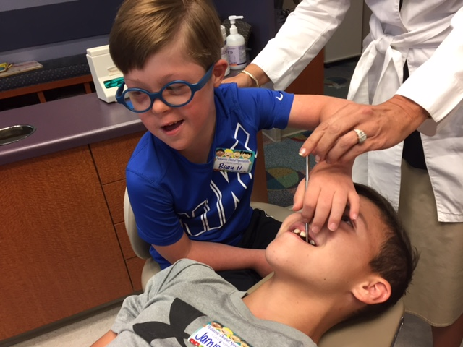
Providing value in dental Medicaid: The dentists’ perspective
Jessica Meeske, D.D.S., M.S.
MSDA Annual meeting
June 4, 2018

Slide 2
Overview
Why I see Medicaid
Providing value to my patients and Medicaid Programs
Identifying the value Medicaid brings to my practice
How dentists will react to a value-based system

Slide 3
WHY I SEE Medicaid and why I teach the importance of seeing these patients to my dental students and pediatric residents

Slide 5
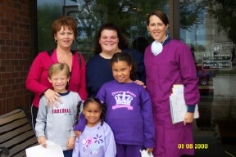
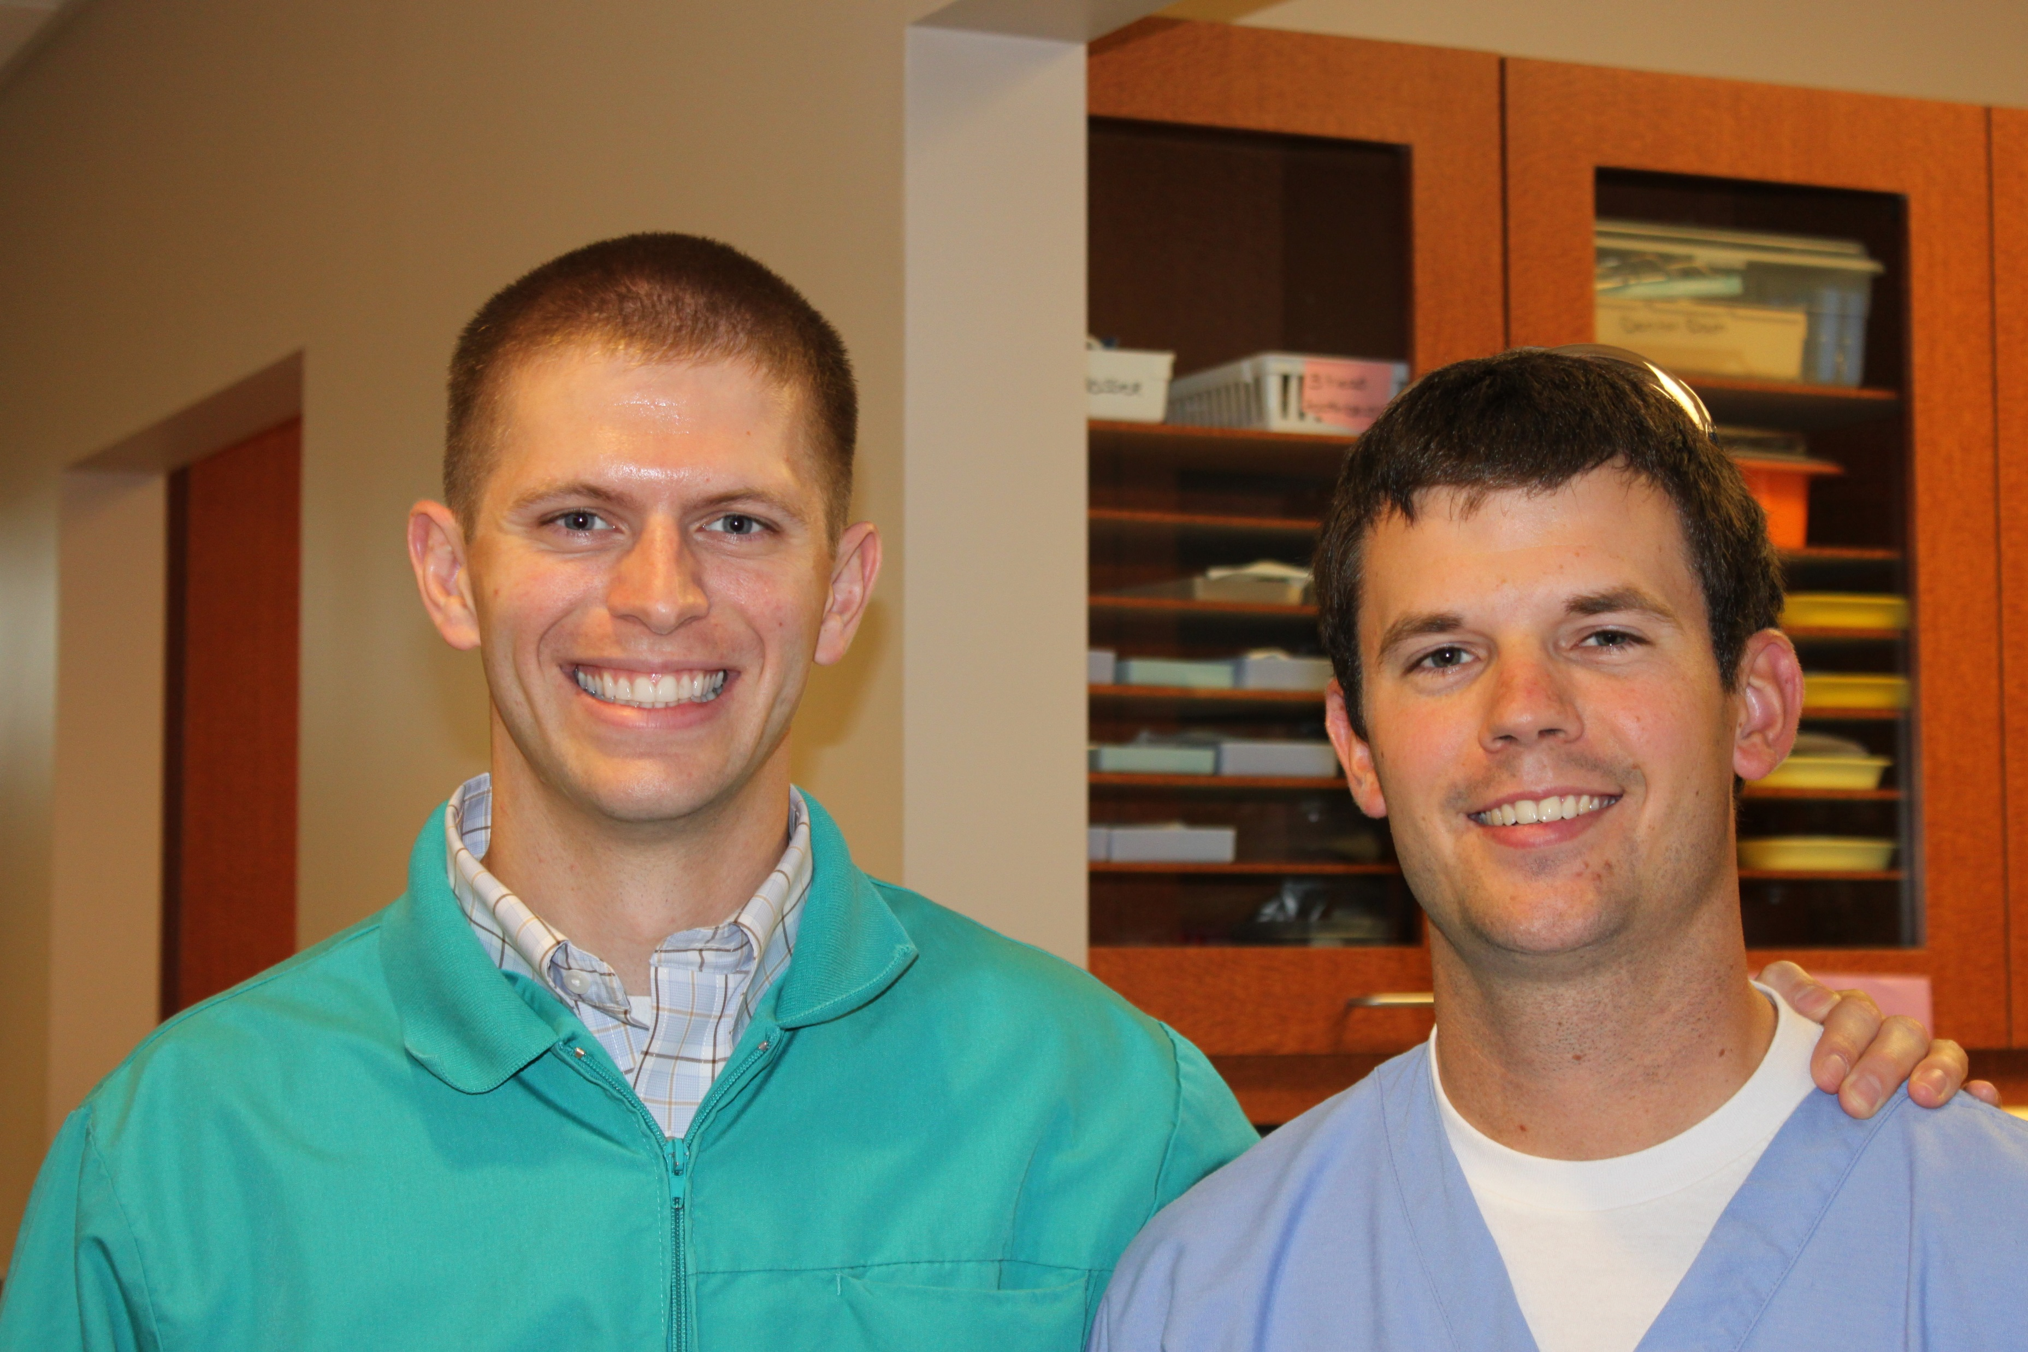
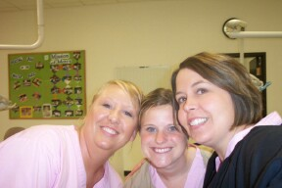
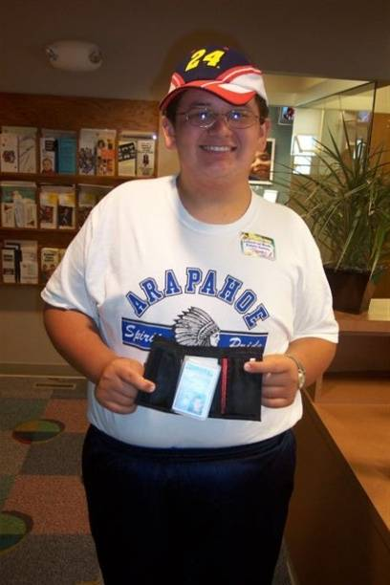
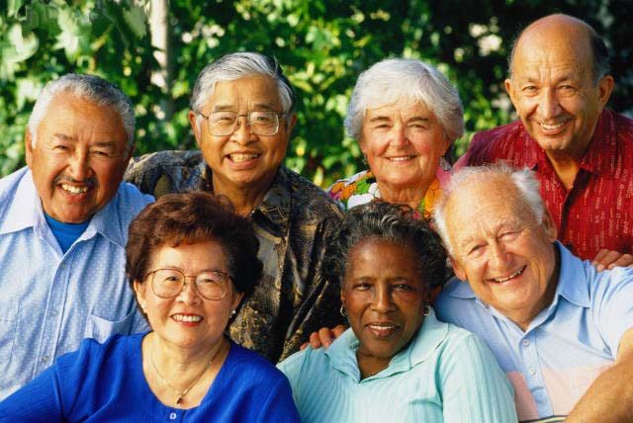
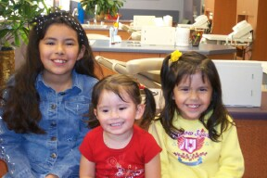
Those Who Rely on Medicaid

Slide 6
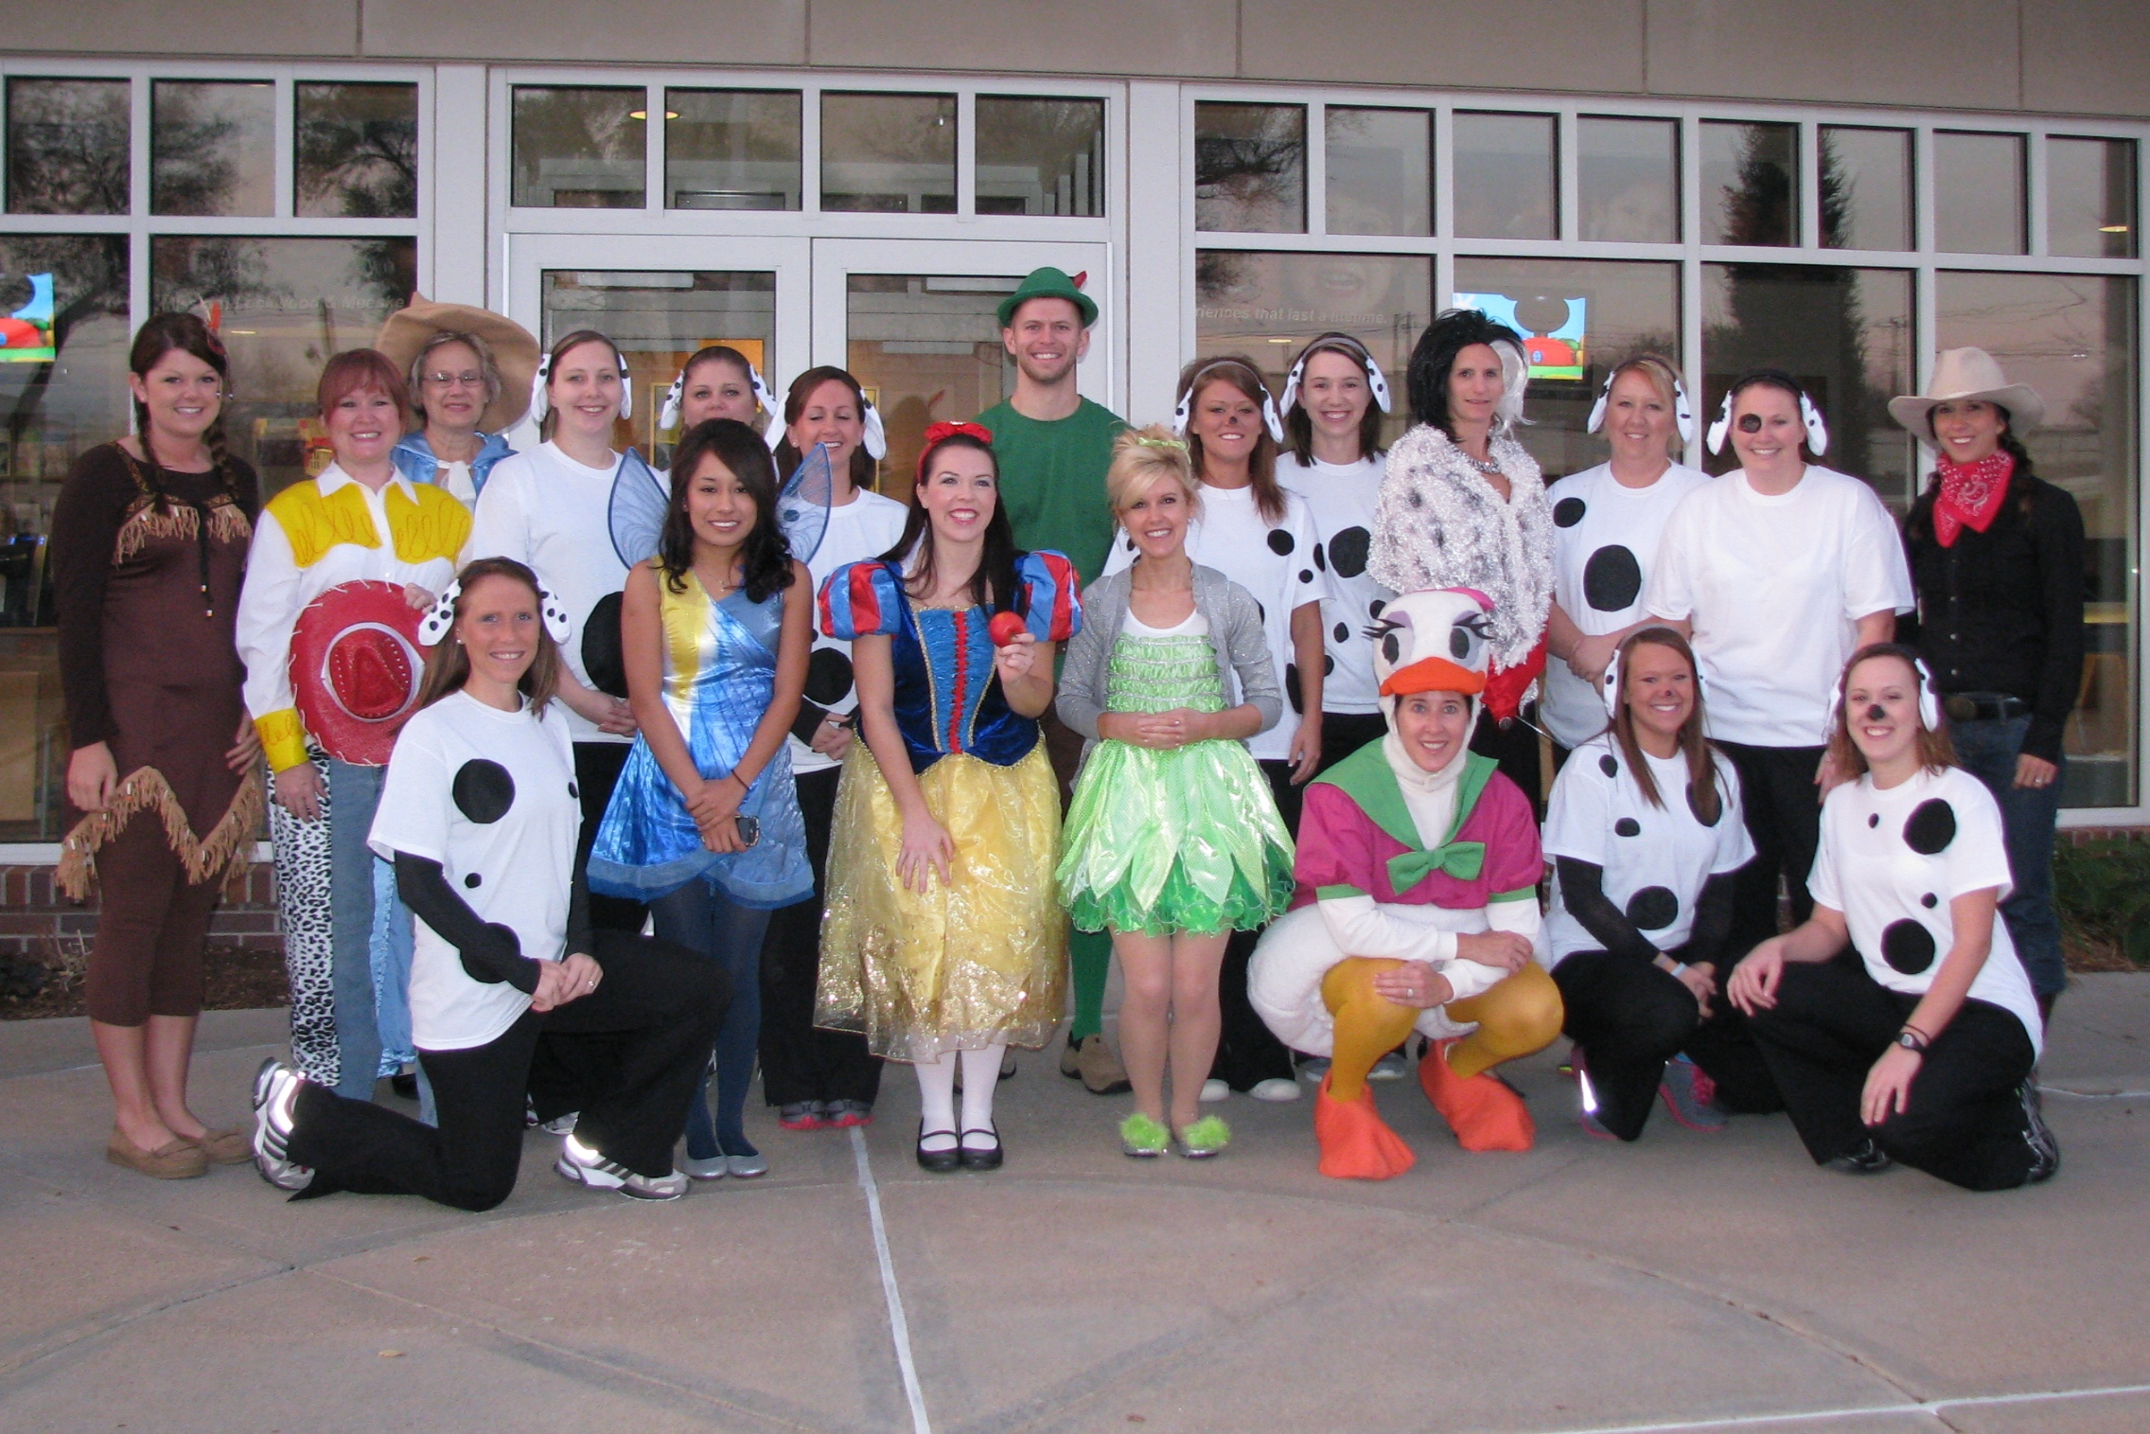
In rural nebraska, they are just “our kids”

Slide 7
What Does the ADA Have to Say on the Topic?

Slide 8
Principle Ethical Considerations in Health Care
Justice
Quality of being impartial and ensuring equity in health care
Autonomy
Informed consent, being truthful, protect confidentiality, moral obligation to the patient
Beneficence
Obligates us to help those in need and give the highest quality of care possible
Non-malfeasance
Do no harm

Slide 9
Why I see kids with Medicaid
Fundamentally believe it’s the right thing to do
Patients are more interesting in their SES makeup and in their mouth
Patients and parents often believe you are changing their lives as opposed to making them late for soccer or piano lessons
Believe I’m serving a greater good
Someone in my family relied on a gov’t program to get ahead in life
I don’t believe in “cherry picking your patients” just like teachers don’t cherry pick their students

Slide 10
Seeing kids on Medicaid AND being successful is like….

Slide 11
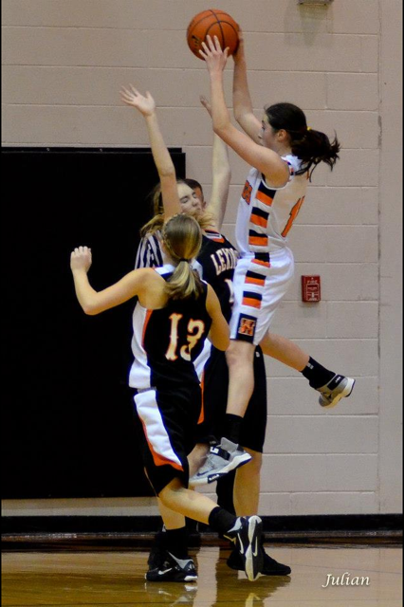
Being the shortest player on the basketball team, and getting doubled teamed on defense, and still coming out on top!
It takes GRIT!

Slide 12
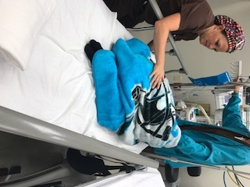
How dentists can provide value to patients with Medicaid and Medicaid programs

Slide 13
Dentists providing value
Follow the provider manual and have a Medicaid Compliance Plan
Have a clear understanding of “medically necessary dental care”
Think about every patient as if you were the primary care giver in terms of “Is this the best I can do for this child and family with the resources I have to work with?
Will my treatment address pain, further problems, and make for a better dental patient, medical patient, and student ready to learn in school?

Slide 14
Dentists providing value
Think about treatment plans and remember the tax payer
Am I providing the least costly service that addresses the problem?
Minimize the number of trips to dentist
Use every means possible to confirm appt’s and reduce chances of not getting treatment done
Conduct self-audits to find mistakes and correct them prior to billing
I provide value to the program/MCO when I do things right by not wasting their time

Slide 15
The No-Charge Dental Visit

Slide 16
I provide value-added dental services every day
The “Meesk-in-ator”

Slide 17
Understanding the value Medicaid brings to the dentist and dental practice

Slide 18
Lose the mindset, “I don’t have control over Medicaid and the patients”
Dentists have more control than they realize!

Slide 19
Understand what you can control and what you can’t
Can control |  | Some control | Can’t control
Time |  | Contractor/RFP | Who the kids’ parents are and the choices they’ve made
Treatment plans |  | Dentists hired to work within contractor/program | How child presents on 1st visit
Clinic space/patient flow |  | Medicaid fee schedule | Who brings child to appt
My supplies |  | Policy makers feelings about value of Medicaid | Child becoming ill
Dental team members I choose to hire and how duties are delegated |  | Provider manual | Weather
Behavior management plans |  | Patients showing up | Child’s homelife
Office policies |  | Shaping child’s behavior | That I get profiled by payers
Payer mix |  | How my dental associations choose to respond

Slide 20
Just consider the “Time” factor
Create templated schedules that maximize dental team’s time. These are NOT quotas. Think about it like the airlines in terms of efficiency.
Children are appointed time slots based on their risk factors and parents.
Do not spend long amounts of time with low risk patients and parents who get it
Do not waste time when all options for getting parent buy-in have been exhausted
When you have a parent relationship built on trust, you need to explain very little
Need little time for patients under 3 y/o
Parents receive multiple messages to confirm appt including auto text

Slide 21
Recognizing and embracing the Non-tangible benefits
Dental team takes pride in providing care to underserved patients
Community partners refer to YOU first
Creates for yourself/practice greater credibility with policy makers and fellow health care providers
Parents love you, even if they don’t know how to show it
Legislators love you because you are taking care of their underserved constituents and trying to be part of the solution

Slide 22
Finding the balance when it comes to being successful financially
It can be profitable. More disease = more treatment/time unit
Add procedures on same date of patient’s appt (extract over-retained tooth, sealants, fillings)
In expanded duty states, you can delegate quite a bit
Waste little time on reviewing the payment options with parents
Avoid procedures that don’t pay if comparable one that does pay better
Balance money winners with money loser procedures

Slide 23
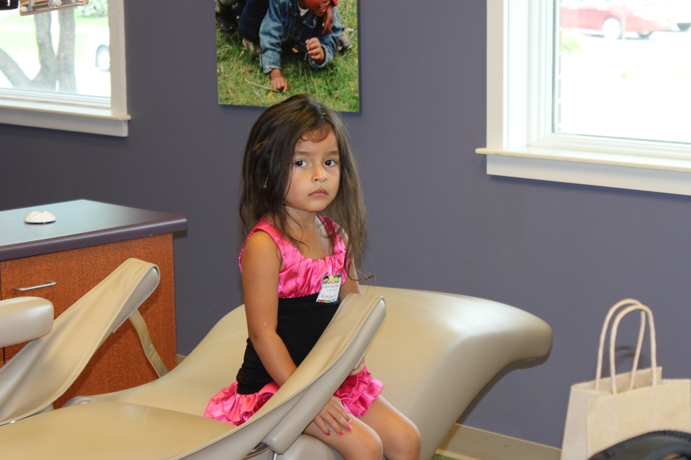
“When you see Medicaid, you wear a badge of honor and share a fellowship with your fellow dentists whom also do.”

Slide 24
The ultimate financial win
These kids grow up, many go to college, and will bring their own kids back often with a higher reimbursing insurance plan
Many parents WILL pay for non-covered services if you take the time to explain why the child needs it.

Slide 25
Every kid has a story

Slide 26
What comes with a hurricane warning today often turns into a rainbow tomorrow

Slide 27
How dentists may react to a value-based system
Must proact and NOT react
Must share the science of what works
They want to be rewarded for the good outcomes and if they have better success rates compared to peers
They want less prior auth if they have a proven track record of following the rules
They want data about their performance compared to peers that is helpful in guiding behavior changes and not penal

Slide 28
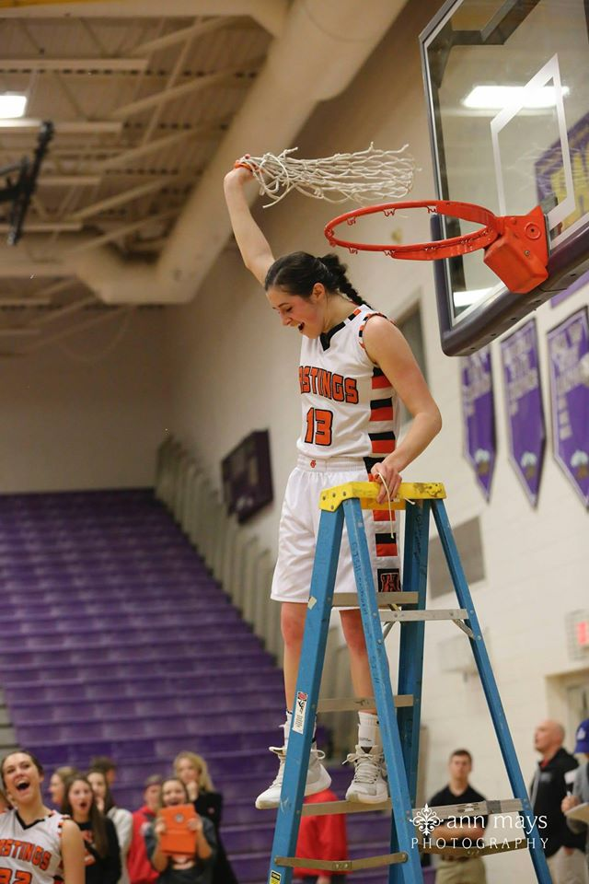
You Will Not Have a Personal Fan Club for Being “GOOD” at seeing Medicaid

Slide 29
But….
“If you become a student of Medicaid, an advocate for your patients, create a culture of positive thinking in your practice, work tirelessly with program managers for change, and find other like-minded dentists to share your trials, the rewards are great.

