Slide 1

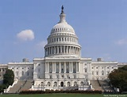
American Academy of Pediatric Dentistry
C. Michael Gilliland
August 5, 2016
Notes:
Note – 3D supergraphic ‘mask’ is now a selectable object in foreground of slide.

Slide 2
Presidential Election

Slide 3
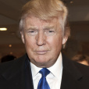
2016 Republican Presidential Watch
Candidate |  | Key Advantages | Key Disadvantages
 | Donald Trump Businessman and TV personality | •Draws crowds & media; high name ID; riveting figure •Billionaire, can self-fund if he wants •Won all over the country during the primary | •Has committed supporters, but may have difficulty expanding beyond his base •Weak fundraising •Has alienated key voting demographics •Strongly opposed by a near-unanimous GOP leadership

Slide 4

2016 Democratic Presidential Watch
Candidate |  | Key Advantages | Key Disadvantages
 | Hillary Clinton Ex- Secretary of State | •Stronger than she was eight years ago •Overwhelming support from party leaders •Dual support from women, minorities hard to overcome, particularly after Iowa and New Hampshire •Excellent campaign organization •Fundraising | •Private emails, Clinton Foundation scandals still playing out •Keeping Bill in check – and on the porch •Likeability factor

Slide 5
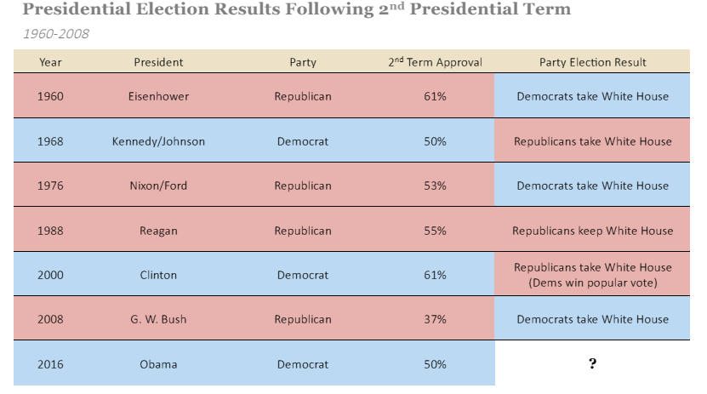
After Two-Term Presidencies, Parties Rarely Maintain Control of the White House

Slide 6
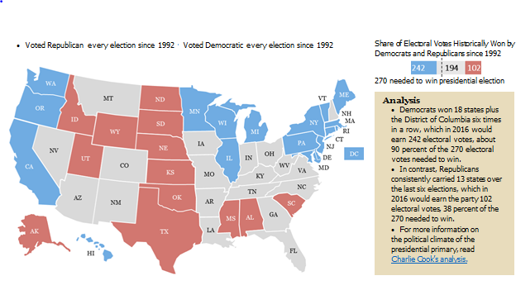
Based on Past Presidential Elections, Democrats May Hold a Slight Advantage Heading into 2016 General Election
States That Voted Consistently in the Past Six Presidential Elections

Slide 7
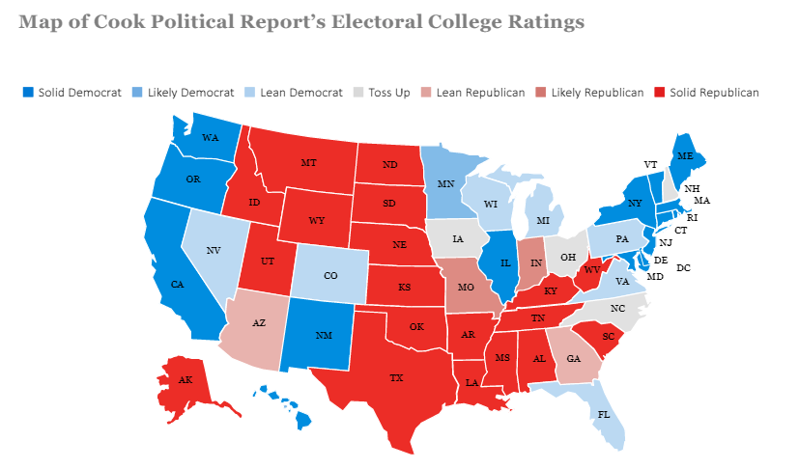
Several Swing States Lean Democrat Giving Democrats An Even Greater Advantage in Presidential Election

Slide 8
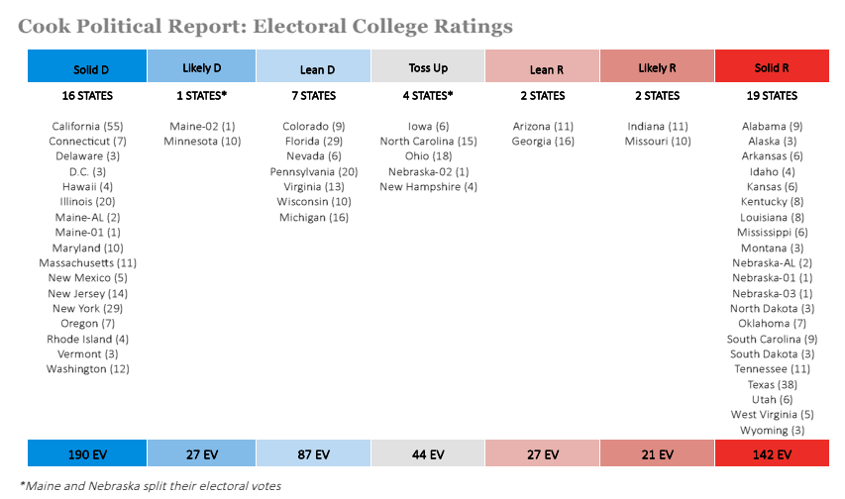
Cook Ratings Favor Democrats in Presidential Election

Slide 9
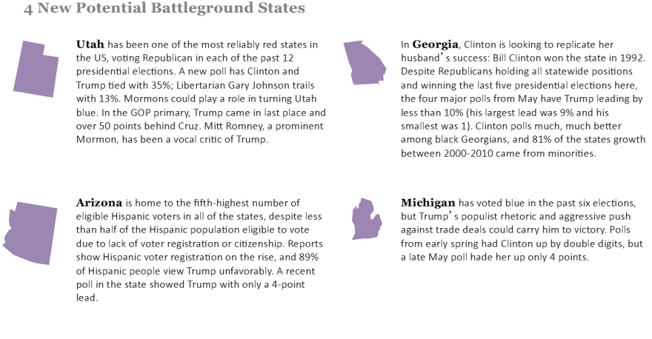
2016 Election May See New Swing States

Slide 10
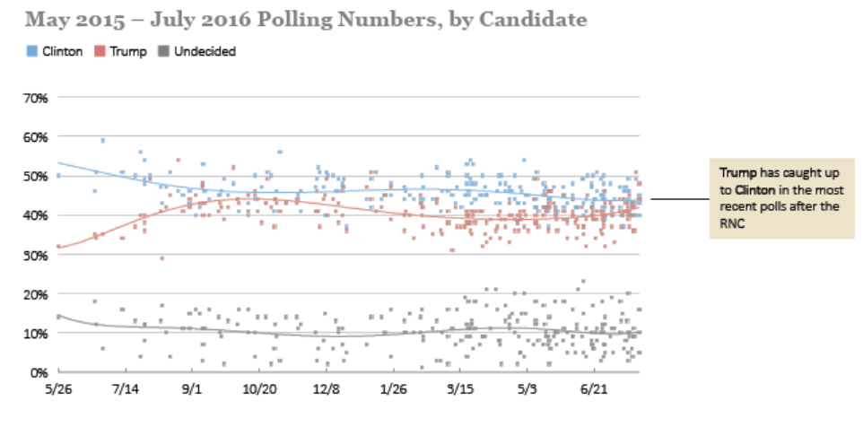
Clinton and Trump Have Been Head-to-Head in National Polls

Slide 11
POST CONVENTIONS POLLS – August 2, 2016
RACE | POLL | RESULTS | SPREAD
General Election: Trump vs. Clinton | Economist/YouGov | Clinton 46, Trump 43 | Clinton +3
General Election: Trump vs. Clinton | NBC News/SM | Clinton 50, Trump 42 | Clinton +8
General Election: Trump vs. Clinton vs. Johnson vs. Stein | Economist/YouGov | Clinton 41, Trump 36, Johnson 8, Stein 4 | Clinton +5
General Election: Trump vs. Clinton vs. Johnson vs. Stein | NBC News/SM | Clinton 42, Trump 38, Johnson 9, Stein 4 | Clinton +4
President Obama Job Approval | Economist/YouGov | Approve 48, Disapprove 49 | Disapprove +1
Congressional Job Approval | Economist/YouGov | Approve 10, Disapprove 71 | Disapprove +61
Direction of Country | Economist/YouGov | Right Direction 27, Wrong Track 64 | Wrong Track +37

Slide 12
POST CONVENTIONS POLLS – August 1, 2016
RACE | POLL | RESULTS | SPREAD
General Election: Trump vs. Clinton | CBS News | Clinton 47, Trump 41 | Clinton +6
General Election: Trump vs. Clinton | CNN/ORC | Clinton 52, Trump 43 | Clinton +9
General Election: Trump vs. Clinton vs. Johnson vs. Stein | CNN/ORC | Clinton 45, Trump 37, Johnson 9, Stein 5 | Clinton +8
General Election: Trump vs. Clinton vs. Johnson vs. Stein | CBS News | Clinton 43, Trump 38, Johnson 10 | Clinton +5
Pennsylvania: Trump vs. Clinton | PPP (D) | Clinton 49, Trump 45 | Clinton +4
Pennsylvania: Trump vs. Clinton vs. Johnson vs. Stein | PPP (D) | Clinton 45, Trump 42, Johnson 4, Stein 2 | Clinton +3

Slide 13
Clinton campaign will target at least two of the four Leans or Likely Republican states, which would have the effect of helping Democratic Senate nominees where they exist (all of those states have Senate races in November). Because Clinton’s objectives include recapture of the Senate, her campaign will target the contests that could yield the net four seats for a tied Senate or five seats for outright Democratic control.
Given the high level of party polarization existing in 2016, the election will likely not resemble the landslides of 1964 (Lyndon Johnson-Barry Goldwater) or 1972 (Richard Nixon-George McGovern). Instead of the winner topping 60% as in 1964 and 1972, it is more likely Clinton would garner less than 55% of the two-party vote.

Slide 14
The polling averages for a Clinton-Trump face-off show roughly a seven to nine percentage point lead for the Democrat. This kind of Democratic advantage would produce an Electoral College result similar to, or greater than, Barack Obama’s 2008 total of 365 electoral votes to John McCain’s 173 (Obama won the national popular vote by 7.3 points). Again, this suggests that one or more states currently rated likely Republican (Arizona, Georgia, Indiana, and Missouri) might slip into the Democratic column.

Slide 15
Trump supporters argue that his appeal to many blue-collar whites in Rust Belt states (such as Michigan, Ohio, Pennsylvania, and Wisconsin) could pull these states’ electoral votes into the Republican column. There is little evidence that the non-college voters supporting Trump in the primaries are defectors from the Democrats. The net addition for Trump could be small.
Trump supporters also argue that increased Republican primary turnout this year means Trump is going to bring out millions more white and primarily male voters that weren’t excited by John McCain in 2008 and Mitt Romney in 2012. It’s possible there will be higher white male voter participation, but there will probably be a heavy Democratic minority turnout to balance it. Also, some white voters, particularly those with higher incomes and levels of education who may have voted for Romney, might have a hard time pulling the lever for Trump.

Slide 16
In 2012, 93 percent of Republicans who voted did so for Mitt Romney. Trump will likely not receive 80 percent of what probably will be a smaller Republican turnout.
Romney lost 73 percent of the Hispanic vote; Trump is viewed unfavorably by 82 percent of Hispanics and very unfavorably by 62 percent. Trump probably will likely receive significantly less than Romney’s 27 percent of this vote. Hispanic turnout probably will be larger than in 2012, as the white percentage of the electorate continues to shrink.
Romney won just 37 percent of young voters (18-29); Trump is unlikely even to match this.

Slide 17
Romney received just 44 percent of the total female vote. Today, Trump trails Hillary Clinton among women by 19 points (35 percent to 54 percent).
Republicans need to carry independents by more than Romney’s five points. Even in states that have voted Republican since 2000, Trump is viewed unfavorably by 62 percent and strongly unfavorably by 52 percent.
Most important of all, the national Republican Party appears certain to remain deeply divided. A considerable chunk of GOP voters are likely to go elsewhere on the ballot, or go fishing entirely on Election Day.

Slide 18
The irony is that Hillary Clinton is a beatable candidate with unique vulnerabilities. Other Republican candidates, such as John Kasich or Marco Rubio, might well have started as the frontrunner.
If the GOP loses big this fall it is probable that the party would repair itself by 2020. Four years after the Goldwater debacle, the Republicans elected a president. Four years after the McGovern disaster, the Democrats elected a president. Republicans, however, will have to find ways to heal the deep rifts in their party, while becoming more mainstream and accommodating to this century’s American electorate.

Slide 19
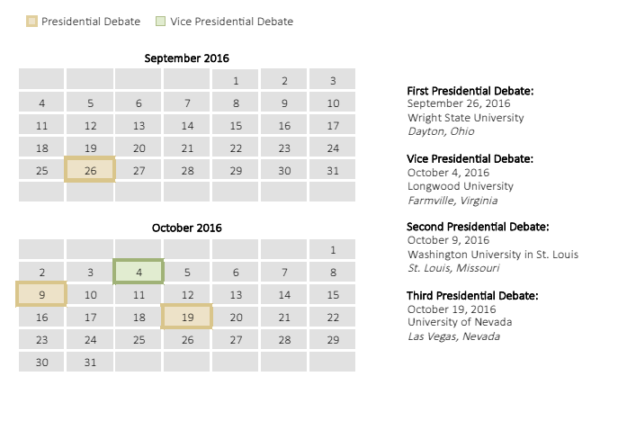
Commission on Presidential Debates Decides on Debate Sites for General Election

Slide 20
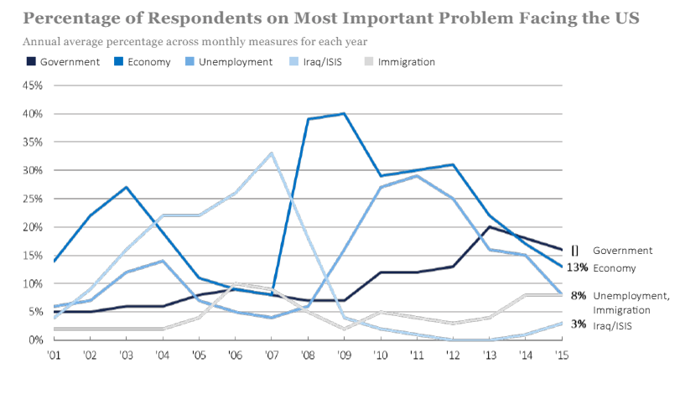
Government is Seen As Biggest Problem in US Second Year in Row

Slide 21
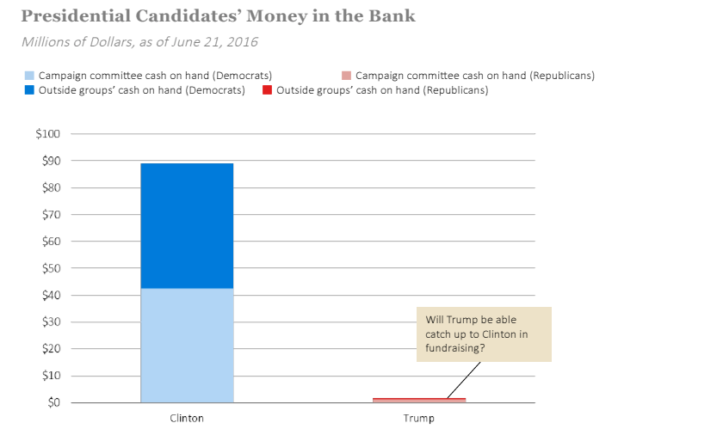
Clinton Has More Money Left to Spend Than Trump

Slide 22
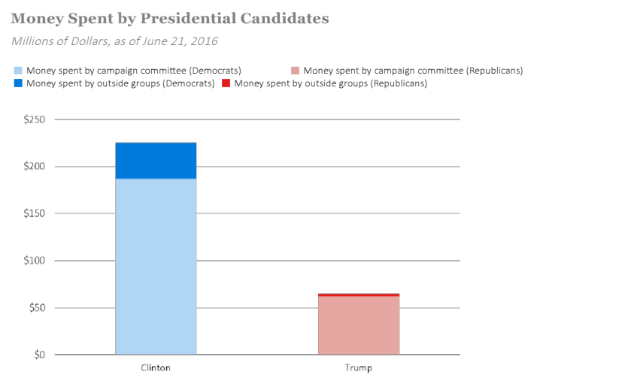
Clinton Has More Money Left to Spend Than Trump - cont’d

Slide 23
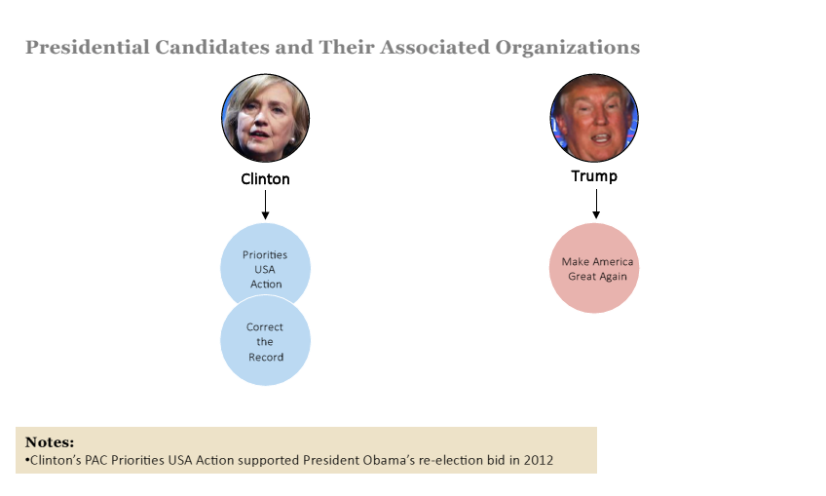
Super PACs Support Clinton and Trump

Slide 24
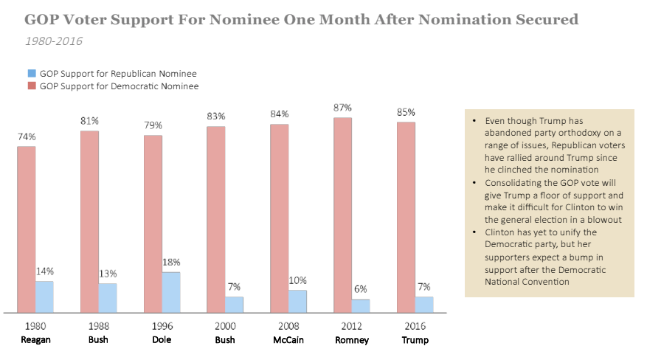
Republicans Are Supporting Trump As Much As They Supported Romney and McCain

Slide 25
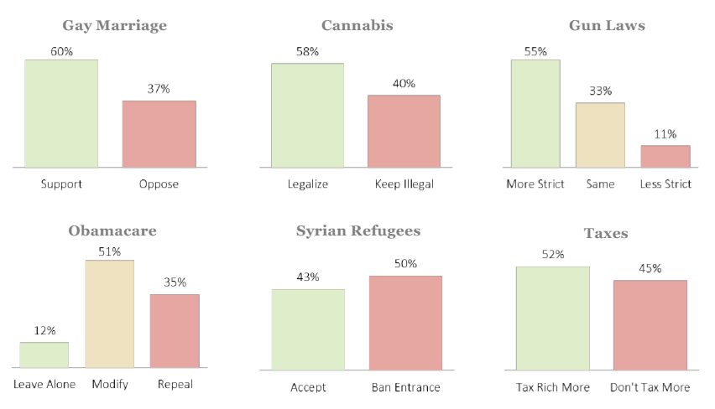
Public Opinion on the Issues as Election Approaches

Slide 26
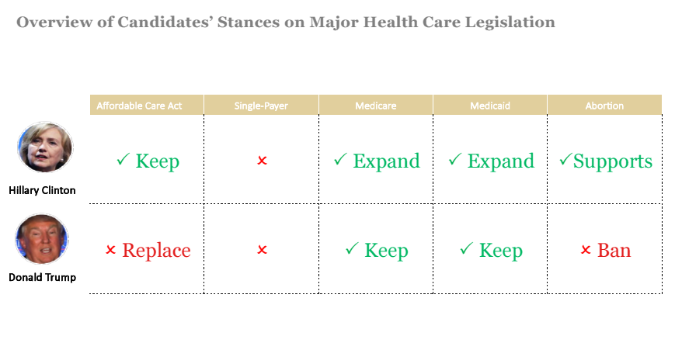
Presidential Candidates’ Health Care Stances Generally Adhere to Respective Party Lines

Slide 27
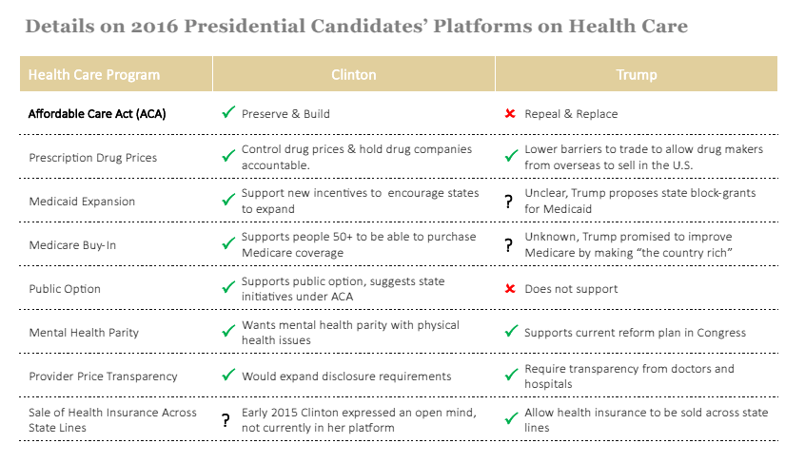
Presidential Candidates’ Stances on Health Policy Span Political Spectrum

Slide 28
Health Care Under Trump and Clinton
DONALD TRUMP
  Donald Trump has made vague references to universal health care without specifying what he means by the term or how he plans to achieve it.
  He has expressed some support for House Speaker Paul Ryan’s health care proposal, which would limit access by creating higher costs for individuals through the following steps.
    Repeal the Affordable Care Act’s (ACA) requirement that all Americans buy health insurance if they are not covered through their work or by a government program;
    Do away with the ACA’s insurance exchanges in the states;
    Set up “high risk” insurance pools to help sick people obtain coverage;
    Provide a tax credit refund for people who buy private health

Slide 29
Health Care Under Trump and Clinton – cont’d.
HILLARY CLINTON
  Hillary Clinton has said she wants to "build on Obamacare. " She has also publicized the topline elements of a health care policy that would take the following steps:
    Letting states install a public option system in which residents could elect coverage in state-managed plans;
    Permitting individuals to enroll in Medicare at age 55;
    Increasing funding for community health care centers in rural areas;
    Granting the Secretary of Health and Human Services authority to limit excessive premium increases;
    Capping out-of-pocket costs paid by consumers for drugs, premiums, deductibles and co-pays, though details remain sketchy;
    Allowing Medicare to negotiate prices with pharma companies;
    Allowing drugs to be imported from abroad.

Slide 30
Senate Elections

Slide 31
Senate Elections
Control of the Senate is at stake again this year.
  In the Senate, 24 Republican seats and 10 Democrat seats are up for election.
  Democrats need to pick up 5 seats in order to take back the Senate and 4 to tie. This assumes Sen. Angus King of Maine continues to Caucus with the Democrats.

Slide 32
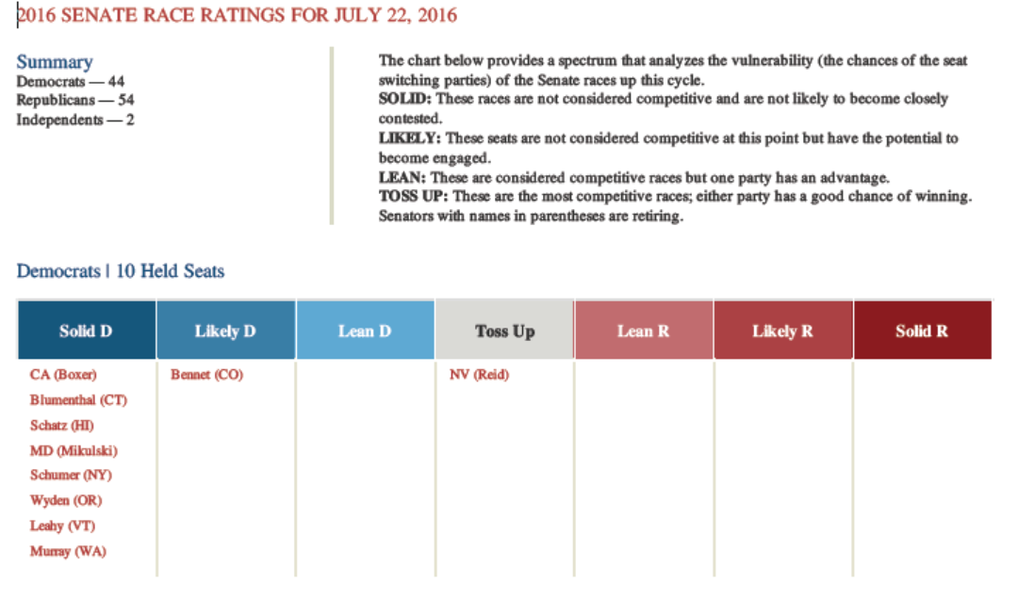
2016 Senate Race

Slide 33
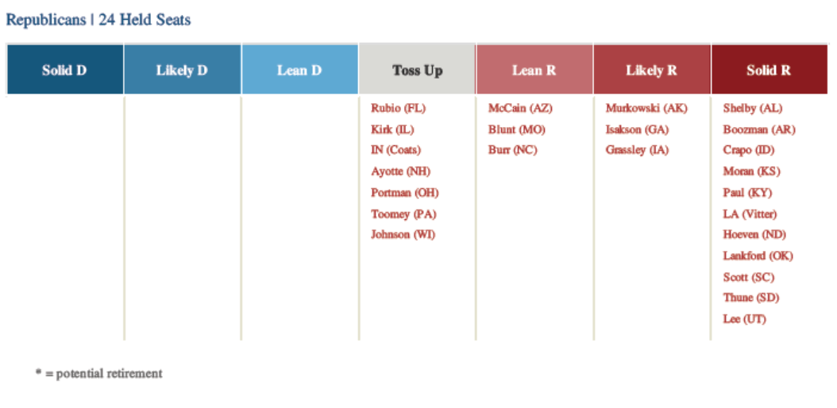
2016 Senate Race - cont’d

Slide 34
Key states in play for Democrats include:
    Florida – Sen. Marco Rubio back in the race.
    Illinois – Sen. Mark Kirk is vulnerable.
    New Hampshire – Sen. Kelly Ayotte is facing a tough challenge from a popular Governor, Maggie Hassan.
    Ohio – Sen. Rob Portman
    Wisconsin – Sen. Ron Johnson is facing Russ Feingold the former Senator he defeated.
    Pennsylvania – Sen. Pat Toomey
Democrats also have seats in play, including:
    Nevada – Sen. Harry Reid is retiring.
    Colorado – Sen. Michael Bennet benefits from tough Republican primary.

Slide 35
Key Factors in the Senate Races
Impact of the Presidential race. A Trump nomination could hurt down ballot Republicans.
  Two Republican seats (Illinois and Wisconsin) lean Democratic, along with several toss ups.
  One Democratic seat leans Republican (Nevada).
  Four other Republican held seats are vulnerable if presidential race is a landslide for the Democrats. (Florida, New Hampshire, Ohio and Pennsylvania.)
The outcome of several remaining primaries.
  In Pennsylvania, Katie McGinty’s defeat of Joe Sestak gives the Democrats a better chance to defeat Pat Toomey and pick up a seat.
  In Florida, Rep. Patrick Murphy likely to win a primary August 30th.

Slide 36
Key Factors in the Senate Races - cont’d
Supreme Court Nominee – McConnell’s refusal to allow hearing/vote an Obama nominee Merrick Garland could hurt Republicans in New Hampshire, Pennsylvania and Ohio.
Inability of Speaker Ryan to frame a message, and policy, that could separate Congress from an unpopular presidential candidate.

Slide 37
House Elections

Slide 38
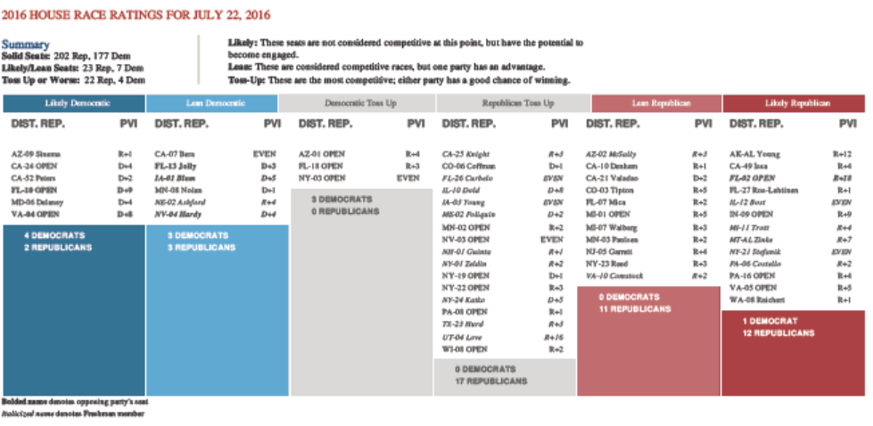
2016 House Race

Slide 39
House Elections
In the House, Democrats would need to pick up 30 seats in order to gain the majority. Republicans are not likely to lose the majority in the House but could lose as many as 12-15 seats making it more difficult for Speaker Paul Ryan to govern.
Latest House ratings:
  227 seats safe or leaning GOP
  188 seats safe or leaning Dem
  20 toss ups – 10 Dems, 10 GOP
Redistricting after 2010 gives Republicans a structural advantage.
  Also, Democratic strength is concentrated in the cities.
  Romney won 224 House districts to Obama’s 211 in 2012.

Slide 40
House Elections
If Clinton wins the White House – Democrats would win White House by a margin bigger than Obama did in 2012 with a coat tail effect on House races.
Hard for one party to win less than 45% of the two-party vote in a presidential contest or win by more than 55%.
  Obama won 53% in 2008 and 52% in 2012. (7th time consecutive time neither party won more than 55%).
Possibility of a Democratic “Wave” in this House is real.
Increase by one point of the vote over 2012 to 53% would result in Dems gaining 9 seats.

Slide 41
House Elections
To win the House, Dems would need to win almost every seat carried by the Dem presidential nominee currently held by a Republican.
Dems would need to defend five seats won by GOP presidential nominee.
A Dem wave could take some safe GOP seats.
A two point increase over 2012 to 54% nationally would result in a net advantage of 35 seats to the Dems.
  GOP would be defending 50 seats in districts won by Dem presidential nominee and two Dem seats held by Romney in 2012.
A three point increase to 55% would leave 56 GOP held seats in blue territory.
  Dems would hold the edge in 241 seats.

Slide 42
House Elections
GOP held districts won by Democratic nominee under three scenarios.

Slide 43
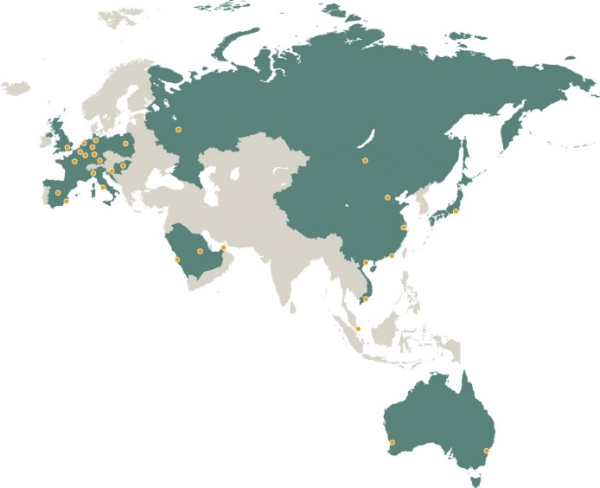
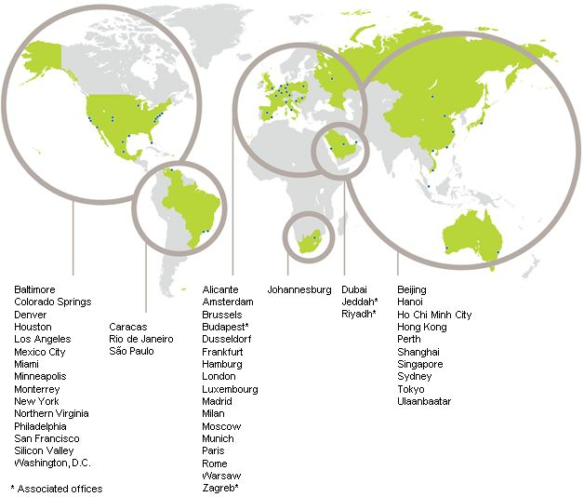
Hogan Lovells Global
Our Offices
Our global presence

Slide 44
C. Michael Gilliland
Partner
Mike.gilliland@hoganlovells.com

