Slide 1

Snapshot of America’s Children
2013

Slide 2
Facts about Children
America’s Children: Key National Indicators of Well-Being, 2012, an annual report to the Nation on the condition of children in America.
http://www.childstats.gov/index.asp
2012 Kids Count Data Book: The Annie E. Casey Foundation.
http://datacenter.kidscount.org/DataBook/2012/Default.aspx

Slide 3
Facts about Children
The Medical Expenditure Panel Survey (MEPS) set of large-scale surveys of families and individuals, their medical providers, and employers across the United States. MEPS is the most complete source of data on the cost and use of health care and health insurance coverage. It collects detailed information on health care utilization and expenditures, health insurance, and health status
http://meps.ahrq.gov/mepsweb/

Slide 4
Facts about Children
National Institutes of Health: National Information Center on Health Services Research and Health Care Technology (NICHSR)
http://www.nlm.nih.gov/hsrinfo/datasites.html
The National Survey of Children’s Health and the National Survey of Children with Special Health Care Needs relates survey results to Healthy People objectives.
http://www.childhealthdata.org/browse/healthy-people-2020

Slide 5
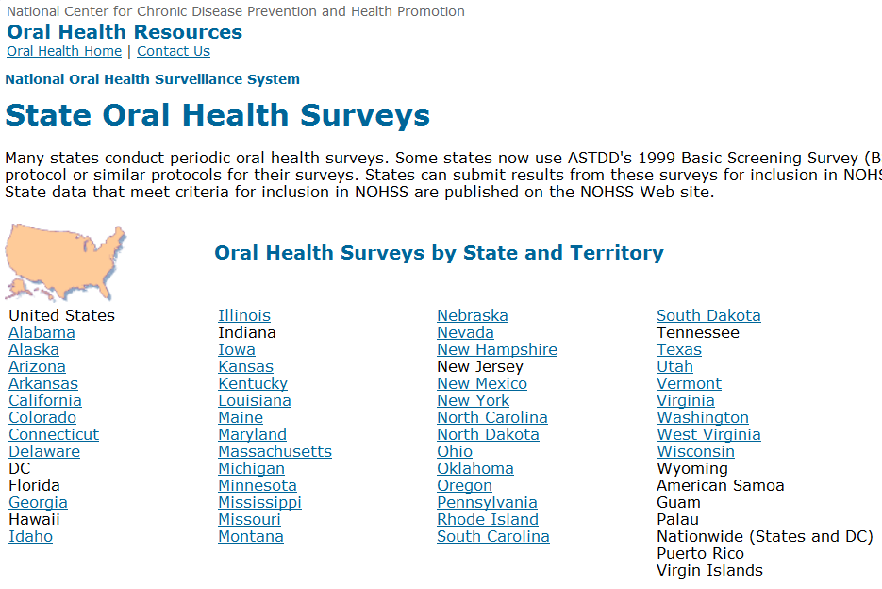
CDC National Oral Health Surveillance System (www.CDC.gov/nohss/)

Slide 6
CDC National Oral Health Surveillance System (www.CDC.gov/nohss/)
CDC National Oral Health Surveillance System provides state by state information on: Percentage of people served by public water systems who receive fluoridated water; Percentage of 3rd grade students with caries experience, including treated and untreated tooth decay; Percentage of 3rd grade students with untreated tooth decay; Percentage of 3rd grade students with dental sealants on at least one permanent molar tooth.

Slide 7
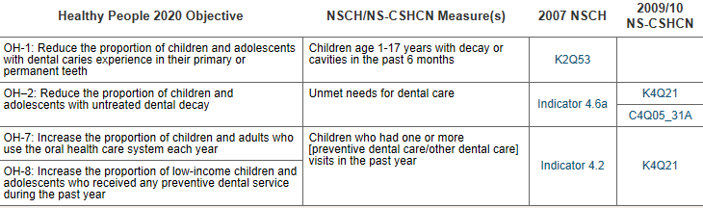
The National Survey of Children’s Health and the National Survey of Children with Special Health Care Needs relates survey results to Healthy People objectives
http://www.childhealthdata.org/browse/healthy-people-2020

Slide 8
Form CMS 416
Used by CMS to collect basic information on State Medicaid and CHIP programs to assess the effectiveness of EPSDT.
Total eligibles* receiving a sealant on a permanent molar
Total eligibles receiving dental diagnostic services.
Total eligibles receiving oral health services by a non-dentist
Total eligibles receiving any dental or oral health service
    (*total who received service/total eligible for EPSDT for 90 continuous days)
    http://www.medicaid.gov/Medicaid-CHIP-Program-Information/By-Topics/Benefits/Early-Periodic-Screening-Diagnosis-and-Treatment.html

Slide 9
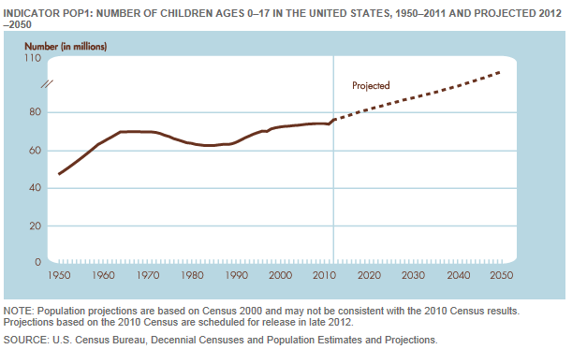
There were 74.1 million U.S. children in 2010
Number of children ages 0–17 in the United States, 1950–2011 and projected 2012–2050
Source: America’s Children: Key National Indicators of Well-Being, 2012

Slide 10
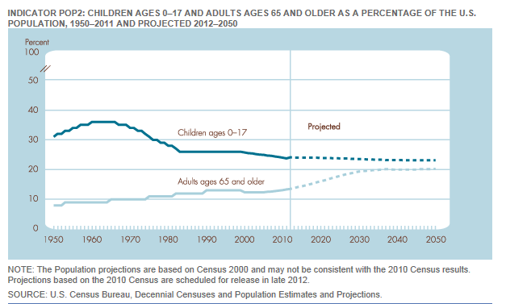
Children comprise about 24% of the population
Children ages 0–17 and adults ages 65 and over as a percentage of the U.S. population, 1950–2011 and projected 2012-2050
Source: America’s Children: Key National Indicators of Well-Being, 2012

Slide 11
Basic Child Stats
Key National Indicators of Well-Being
Economic Well-being
English Proficiency
Child Injury and Mortality
Child Maltreatment
Obesity

Slide 12
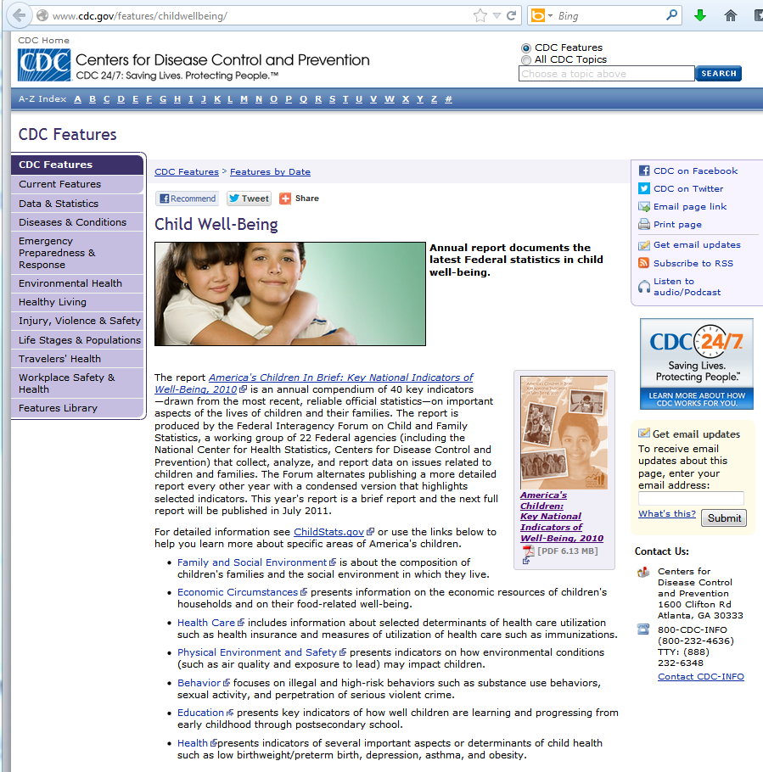
http://www.cdc.gov/features/childwellbeing/

Slide 13
Economic Well-Being
Percentage of children ages 0–17 by family income relative to the poverty line

Slide 14
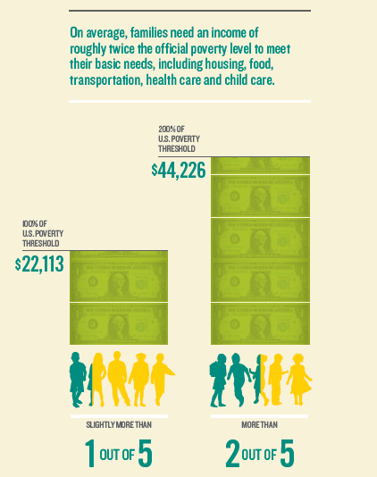
Poverty
2013 US Poverty Threshold
Family of 4: 23,550
1 out of 5 children (22%)
Lived below the poverty line
in 2010
More than 2 out of 5 (44%)
Lived in low-income families
Source: Annie E. Casey Foundation, 2012 Kids Count Data Book

Slide 15
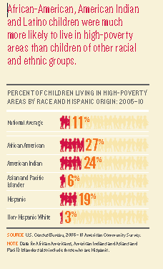
Only the cash income available to families, without accounting for many safety net supports that a family might receive:
  Federal tax credits
  Child care and housing vouchers
  Food aid through the Supplemental Nutrition Assistance Program
Does not reflect the ways in which costs—like housing and child care—vary from region to region
Source: Annie E. Casey Foundation, 2012 Kids Count Data Book

Slide 16
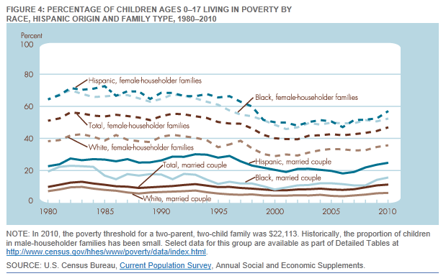
In 2012, the poverty threshold for a two-parent, two-child family was $23,050.
Source: America’s Children: Key National Indicators of Well-Being, 2012

Slide 17
Children in Single Parent Families by Race/Ethnicity
Source: Kids Count, 2012

Slide 18

Food insecurity
A family's ability to put enough nutritious food on the table
About 22 percent of children lived in households that were food insecure at times in 2010,
Federal Programs:
SNAP: USDA's Supplemental Nutrition Assistance Program serves 36.5 million people
USDA's National School Lunch program serves 31 million children
Special Supplemental Nutrition Program for Women, Infants and Children, or WIC serves nearly half of all infants

Slide 19
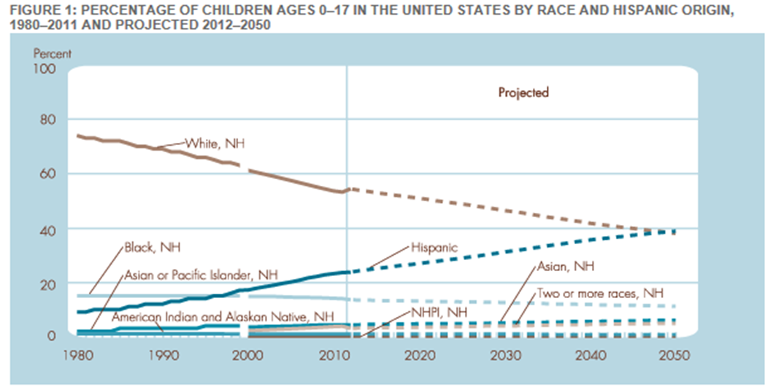
English Proficiency and Racial Diversity
Children with at least one foreign-born parent: 23% (2010)
Children (5-17) who speak a language other than English at home: 21% (2009)
Children (5-17) who have difficulty speaking English: 5% (2009)
Source: America’s Children: Key National Indicators of Well-Being, 2012

Slide 20
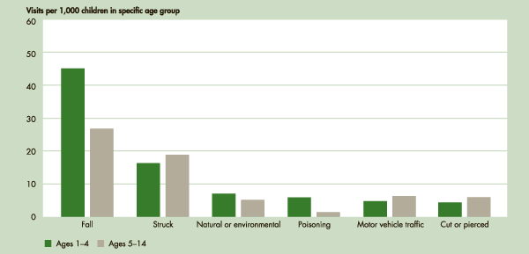
Child Injury and Mortality
Emergency department visit rates for children ages 1–4 and 5–14 by leading causes of injury visits, 2007–2008
In 2000, the total lifetime costs (medical expenses and productivity losses) of injuries among children ages 0–14 were estimated to be over $50 billion.
Source: America’s Children: Key National Indicators of Well-Being, 2012

Slide 21
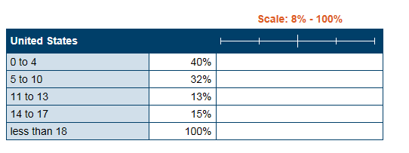
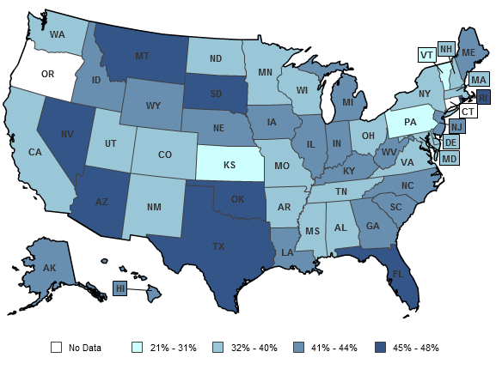
Children confirmed victims of child maltreatment by CPS by age
Child Maltreatment
Children age 0-4 confirmed victims of child maltreatment by state:
Varies from 21% - 45%
Source: Kids Count, 2012

Slide 22
Health Insurance, Dental Visits, and Untreated Caries
Health Insurance Sources
Dental Visits
Untreated Caries
Perceived Need for Dental Services

Slide 23
Poverty Rate and Health Insurance
State with highest rate of uninsured children: Nevada @ 17%
State with lowest rate of uninsured children : Vermont and Massachusetts @ 2%
Source: Kids Count, 2012

Slide 24
Health Insurance by type, 2010
Source: Kids Count, 2012

Slide 25
Dental Visits
Questions to ask:
How was the data collected
Who was it collected from
What question was asked
Different Sources=Different Information
 | America’s Children (2010) | MEPS (2009) | National Survey of Children’s Health (20011) | CMS 416
“low income” | 52.3% - 77% | 36.9% | 68% - 72% | any dental service: 45% Any dental/OH: 46% Diagnostic: 41%
“High income” | 51.6% -89.3% | 63.9% | 79.7% - 85%
All |  |  | 77.2%

Slide 26
Percentage of children ages 2-17 with a dental visit in the past year by age – 2000/2010
Children were identified as having a dental visit in the past year by asking parents "About how long has it been since your child last saw or talked to a dentist?" In 2001 and later years, the question was "About how long has it been since your child last saw a dentist?" Parents were directed to include all types of dentists, such as orthodontists, oral surgeons, and all other dental specialists, as well as dental hygienists
Poverty Status | Ages 2-4 |  | Ages 5-11 |  | Ages 12-17
 | 2000 | 2010 | 2000 | 2010 | 2000 | 2010
Below 100% | 44.1 | 52.3 | 68.5 | 80.8 | 62.7 | 75.4
100-199% | 47.0 | 54.8 | 73.4 | 81.8 | 68.3 | 77.0
200% and above | 43.7 | 51.6 | 87.5 | 90.9 | 88.2 | 89.3
Source: America’s Children: Key National Indicators of Well-Being, 2012

Slide 27
MEPS (Medical Expenditure Panel Survey)
Uninsured children ages 2–17 received routine dental checkups at lower rates than children who were covered by either public or private insurance (25.9 percent versus 40.5 percent and 56.5 percent)
Poor children made routine dental checkup visits during the last year at lower rates than children from high income families. Almost two-thirds (63.9 percent) of children from high income families reported at least one routine dental checkup visit during the last year as compared with 36.9 percent of children from poor families
Source: June 2011, Statistical Brief #326
Children's Dental Care: Advice and Checkups, Ages 2-17, 2008
27

Slide 28
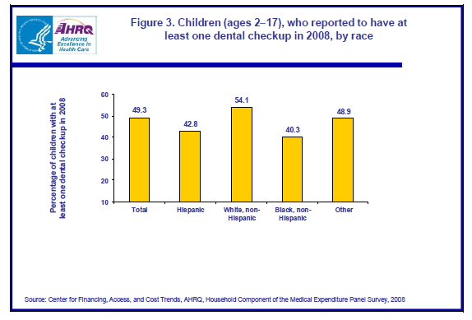
Dental Visits by Race (MEPS)

Slide 29
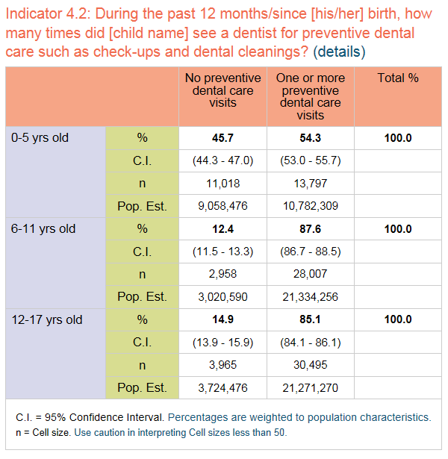
77.2% of Children Received a Preventive Dental Visit in 2011
Publically insured: 73.5
Privately insured: 82.5
Uninsured: 47.7
Source: 2012 Survey of Children’s Health

Slide 30
Varies: 23% - 62%
Source: CMS, Use of Dental Services in Medicaid and CHIP, 2011

Slide 31
Unmet Dental Needs
2012 Survey of Dental Health Parent interviews | CDC Health United States NHANES | CDC National Health Interview Survey parent questionnaire | CDC NHANES Exams by Hygienists – mobile units | America’s Children: Key National Indicators of Well-Being, 2012 | National Oral Health Surveillance System State open-mouth surveys
5.4% | Age 2-5: 19.3 Age 6-19: 15.6 | 7.0% | 13.3% | 9.6% – 21.5% | 3rd grade: 12% - 42.7%

Slide 32
CDC Summary Health Statistics for U.S. Children: National Health Interview Survey, 2010
In 2010, 4.3 million (7%) children aged 2–17 years had unmet dental need because their families could not afford dental care.
Uninsured children (26%) were more than six times as likely to have unmet dental need as children with private health insurance (4%) and more than four times as likely as children with Medicaid or other public coverage (6%).
Non-Hispanic white children were more likely to have had a dental contact in the past 6 months (67%) than non-Hispanic black (55%) or Hispanic (57%) children.

Slide 33
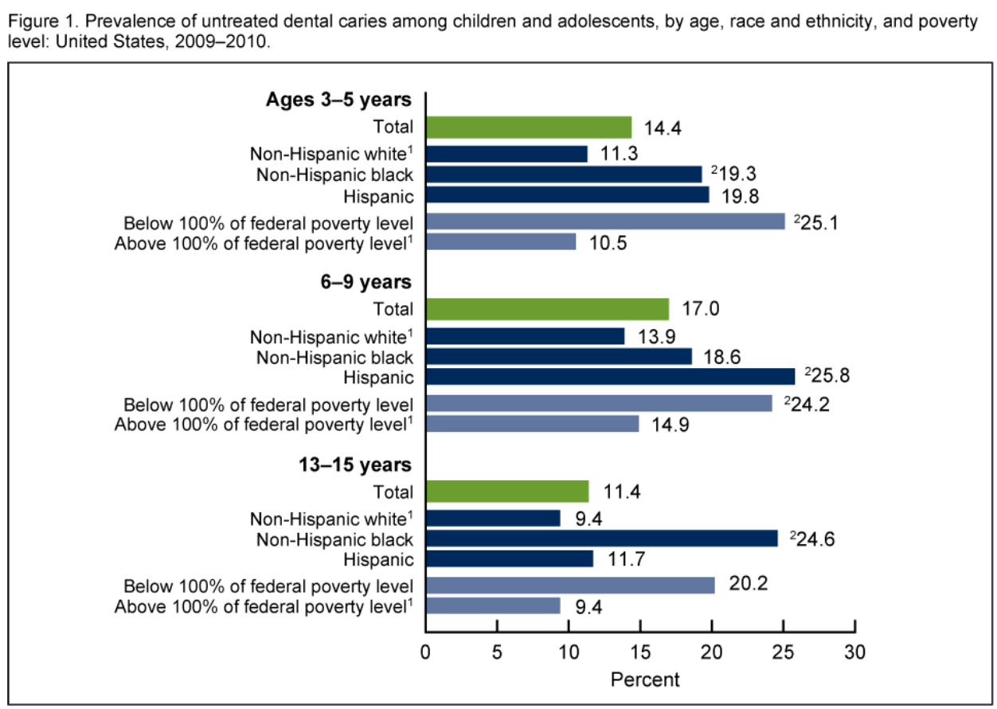
Source: NCHS Data Brief Number 104, August 2012. Oral Health Disparities as Determined by Selected Healthy People 2020 Oral Health Objectives for the United States, 2009–2010

Slide 34
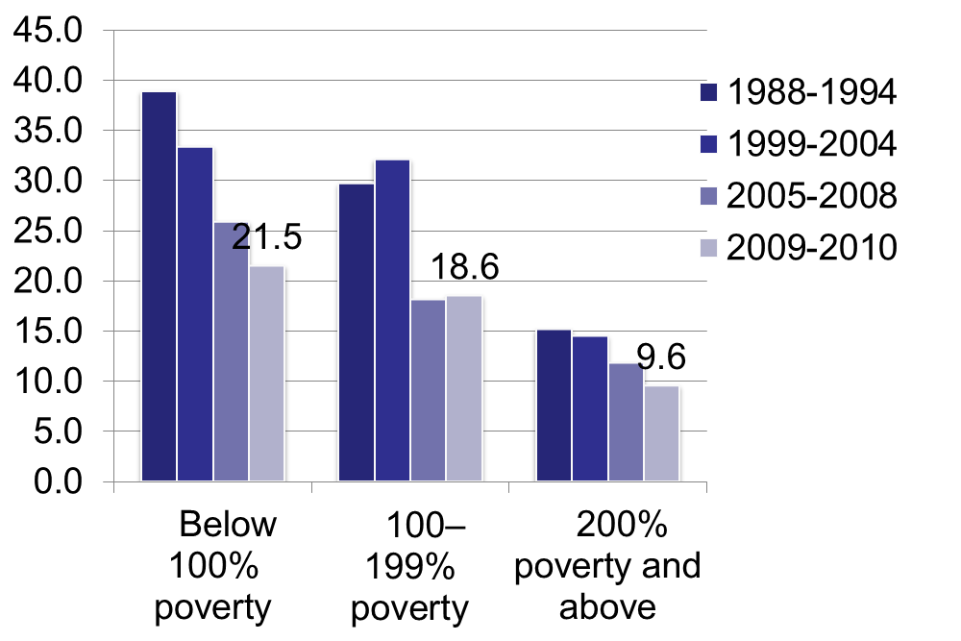
Untreated Dental Caries
Percentage of children ages 5–17 with untreated dental caries (cavities) by poverty status
Source: America’s Children: Key National Indicators of Well-Being, 2012

Slide 35
National Oral Health Surveillance System
Lowest % of 3rd graders – w/ caries experience: CT: 40.6%
Highest % of 3rd graders – w/ caries experience: ID: 67.1%
Lowest % of 3rd graders - untreated tooth decay: NH: 12%
Highest % of 3rd graders - untreated tooth decay: TX: 42.7%
Lowest % of 3rd graders - with dental sealants: SC: 23.9%
Highest % of 3rd graders - with dental sealants: VT: 66.1%
Source: CDC National Oral Health Surveillance System:
school years ranged from 1999 - 2011

Slide 36
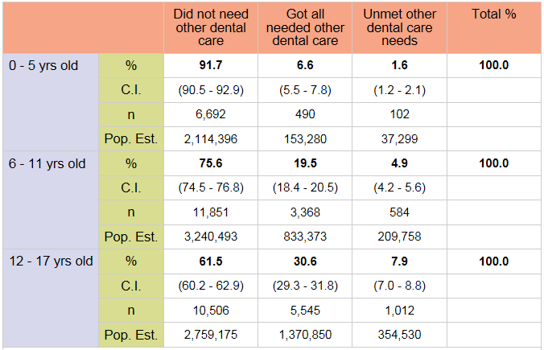
All children: Perception of Need
Did not need dental care: 73.3%
Got all needed dental care: 21.3%
Unmet dental care needs: 5.4%
Source: 2012 Survey of Children’s Health

Slide 37
Percent of Parents Reporting Unable to Get Dental Care by Age
Untreated Caries
Age 3 – 5: 14.4
Age 6 – 9: 17.0
Age 13 – 15: 11.4
Source: www.healthindicators.gov, accessed 6/11/13

Slide 38
Access vs. Utilization
Parents reported “no dental care needed” age 0-5 91.7%
Unable to get care age 0-4 2.3%
Untreated Caries age 3-5 14.4%
Health Literacy: Nearly one half of American adults have difficulty understanding and acting upon health information (IOM, 2004)

Slide 39
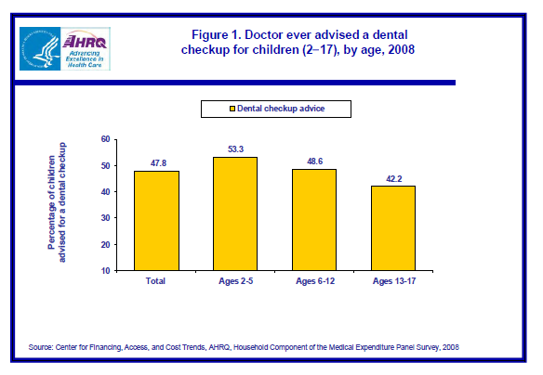
Oral Health in Primary Care
In 2008, less than half (47.8 percent) of children between the ages of 2 and 17 were offered advice from a health care provider about the need for timely routine dental checkups.
Fewer uninsured children received advice from a doctor to have regular dental checkups than those who had public or private insurance (34.5 percent versus 51.9 percent or 47.4 percent)
Source: June 2011, Statistical Brief #
Children's Dental Care: Advice and Checkups, Ages 2-17, 2008 (MEPS

Slide 40
The AAP policy statement on Preventive Oral Health Intervention for Pediatricians reinforces this conclusion. “A pediatrician who is familiar with the science of dental caries, capable of assessing caries risk, comfortable with applying various strategies of prevention and intervention, and connected to dental resources can contribute considerably to the health of his or her patients.”
2009: 50% pediatricians ID caries or address tooth-brushing
Lewis, C., Boulter, S., Keels, M., Krol, D., Mauradian, W., O’Connor, K., & Quinonez, R. Oral health and pediatricians: the results of a national survey. Academic Pediatrics, 2009: 9(6). 457-461.

Slide 41
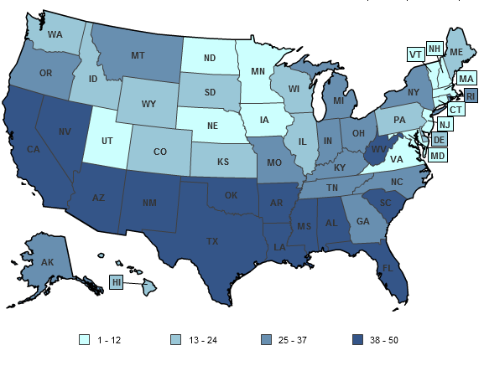
Kids Count—Overall Rank
Percent Low-Birth-weight Babies, Infant Mortality Rate, Child Death Rate, Teen Death Rate, and Teen Birth Rate
Data Source: Population Reference Bureau, analysis of data gathered for the 2012 KIDS COUNT data book.

